Slide 1
MAXIMIZING SWARM COVERAGE: HUNTING FOR MEMBERS OF A MOVING POPULATION Mary Burbage

Slide 2
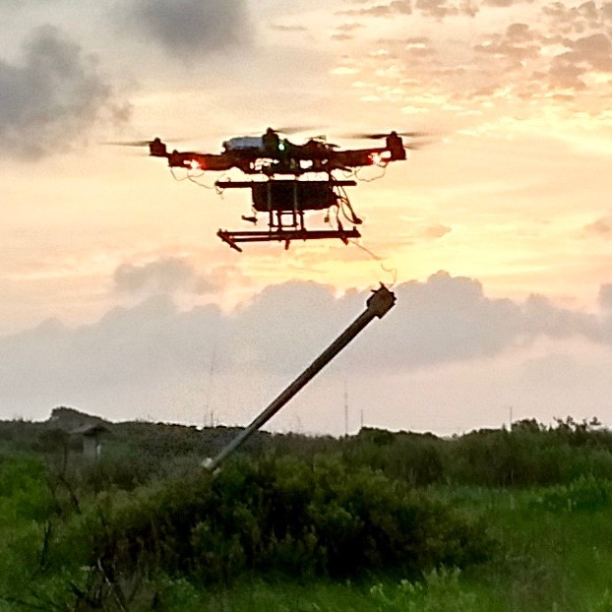
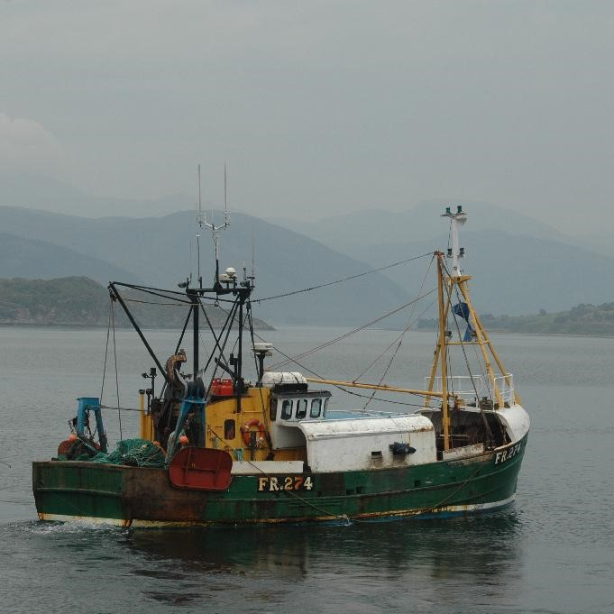
Hunting for Swarms
Mosquito-hunting drone
Image by An Nguyen
Automated Fishing Trawler
Image by An Nguyen

Slide 3
Coverage Problem
Plan a coverage path for a robot such that it encounters each member of a population of mobile particles in a workspace.
For stationary particles or unconstrained time, full spatial coverage is satisfactory.
With mobile particles and a maximum running time, full spatial coverage may not be sufficient.

Slide 4
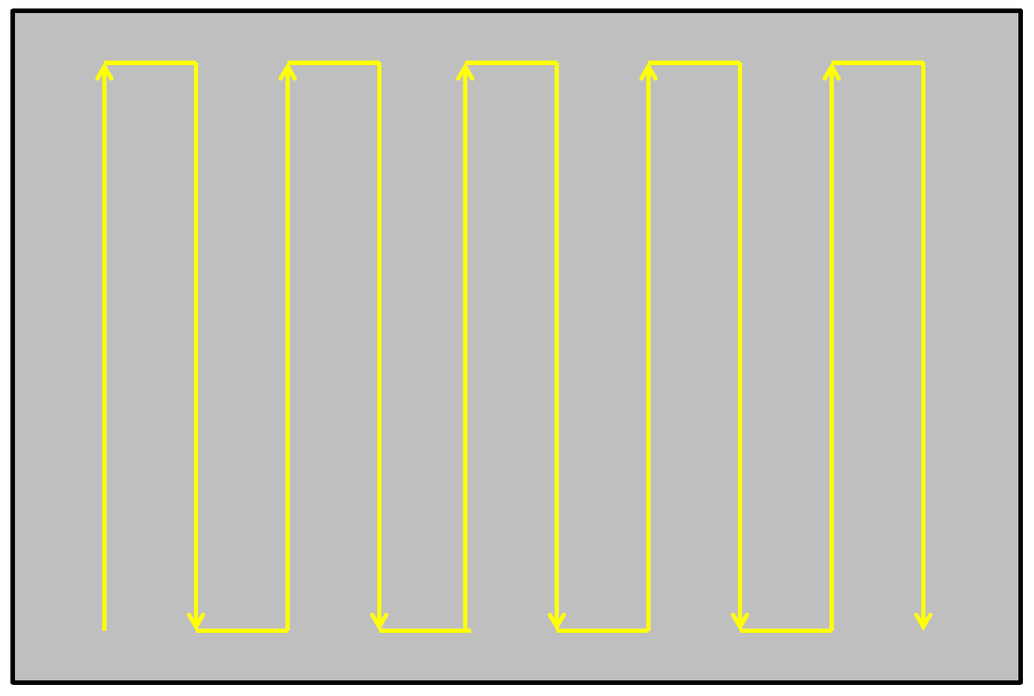
Classic Robotic Coverage
Design a path for the robot that ensures the robot visits within a maximum distance of every point in the workspace
Simplest is a lawn-mowing or boustrophedon path, which guarantees complete spatial coverage [Choset, 2000]

Slide 5
Robotic Coverage – Previous Work
Find ways to subdivide the space around obstacles and apply a boustrophedon-type path [Hert et al, 1996]
Handle moving or unexpected (e.g. unmapped) obstacles [De Carvalho et al, 1997]
Coordinate search among multiple robots [Ge et al, 2005]

Slide 6
Robotic Coverage – Previous Work
Manage localization and sensor measurement uncertainty [Das et al, 2011]
Optimize path connecting static waypoints [Soltero et al,, 2014]

Slide 7
Novelty
Things being searched for can move
Space previously covered can be recontaminated or repopulated
Time is so limited that the whole workspace cannot be searched

Slide 8
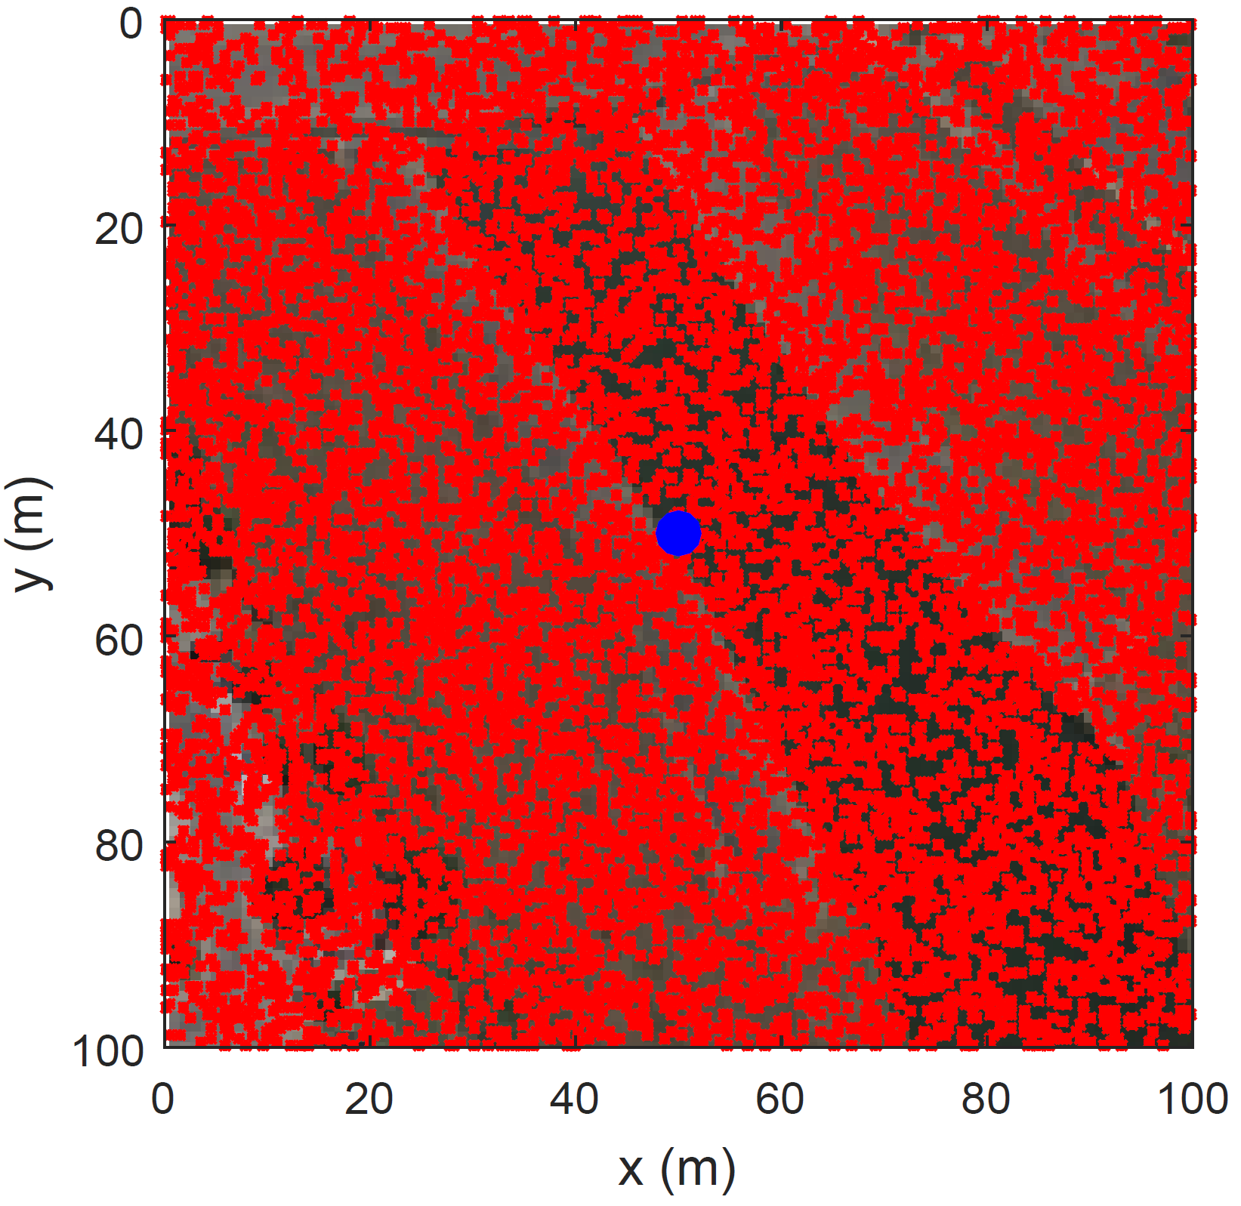
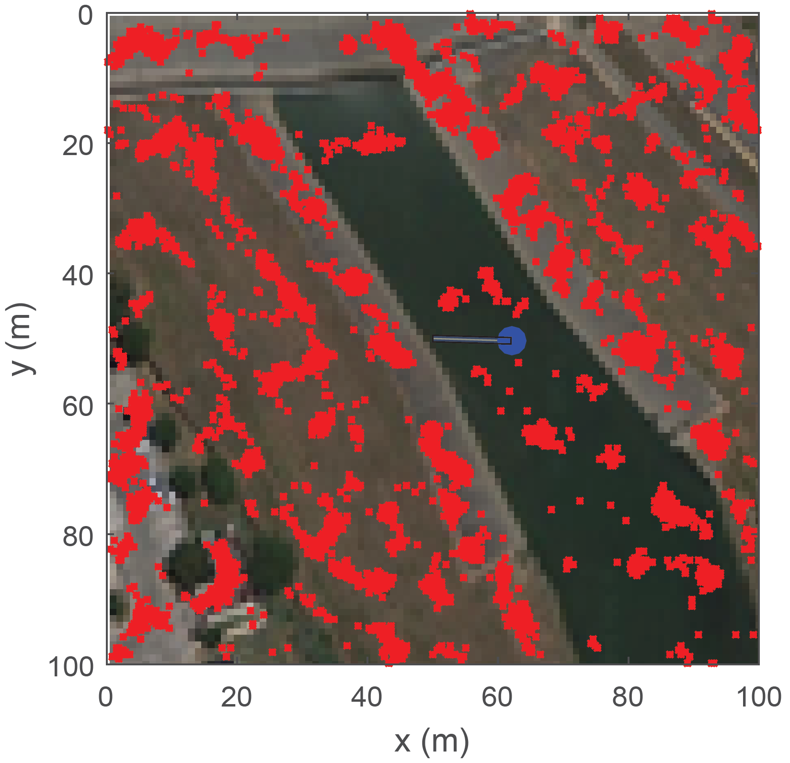
Biasing
Unbiased
Biased

Slide 9
Modeling Mosquito Distributions
Begin with uniform distribution in square area
Set a map as the background for the area
Simulate movement
Can move up to 0.4 m/s [Clements, 1999]
Biased toward greenest area surrounding it plus a random component
Move once every second
Allow mosquitoes to move 5000 steps before robot begins searching

Slide 10
Building a Path
Paths may be precomputed, randomly selected during a search, rely on feedback, or be a hybrid
Each step is of a uniform length for a constant robot velocity
Robot’s collection device is one unit (1 m) wide

Slide 11
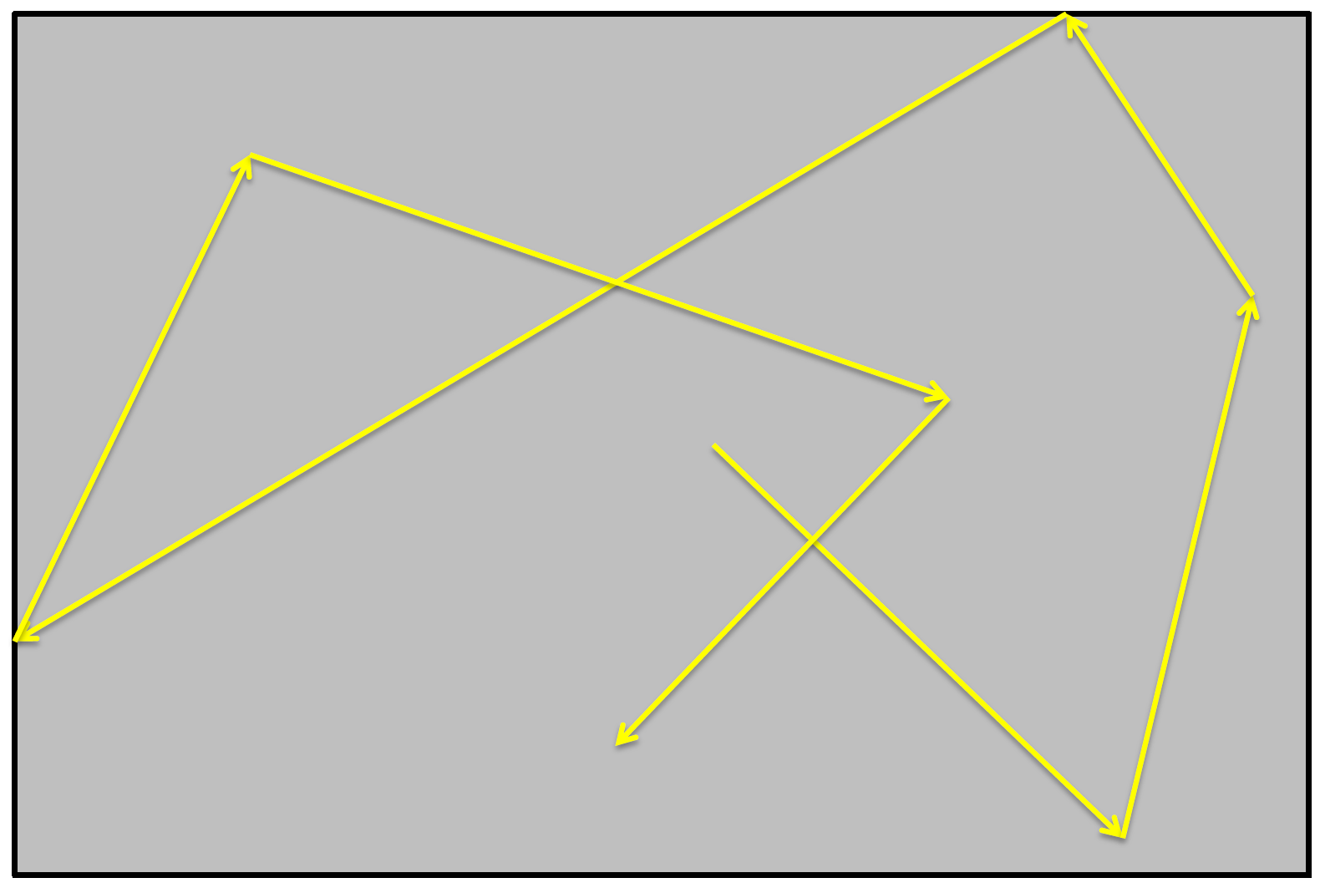
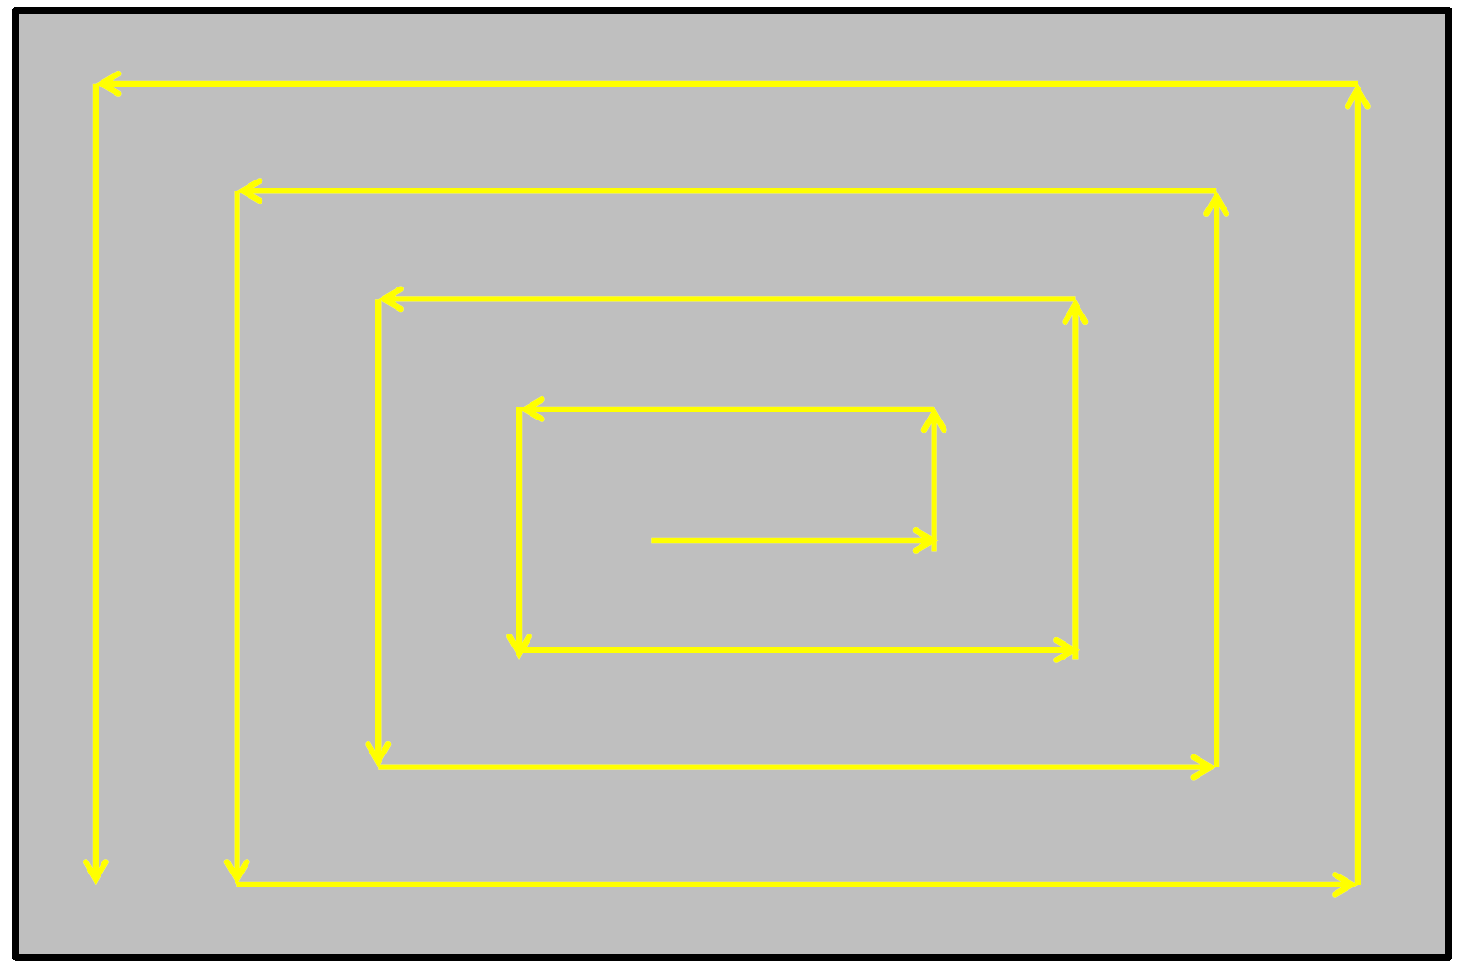
Path Options
Boustrophedon
Random Bounce
Square Spiral

Slide 12
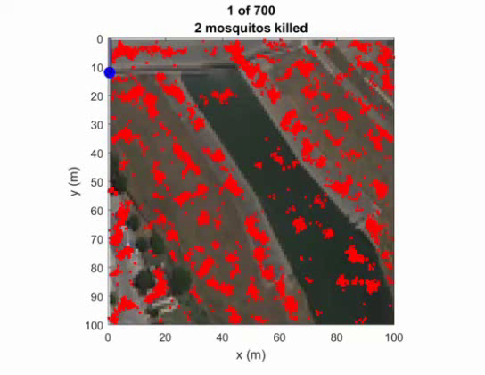
Boustrophedon Simulation

Slide 13

Random Bounce/Spiral Simulation

Slide 14
Paths Tested
Boustrophedon
Boustrophedon with spiral
Random bounce
Random bounce with spiral

Slide 15
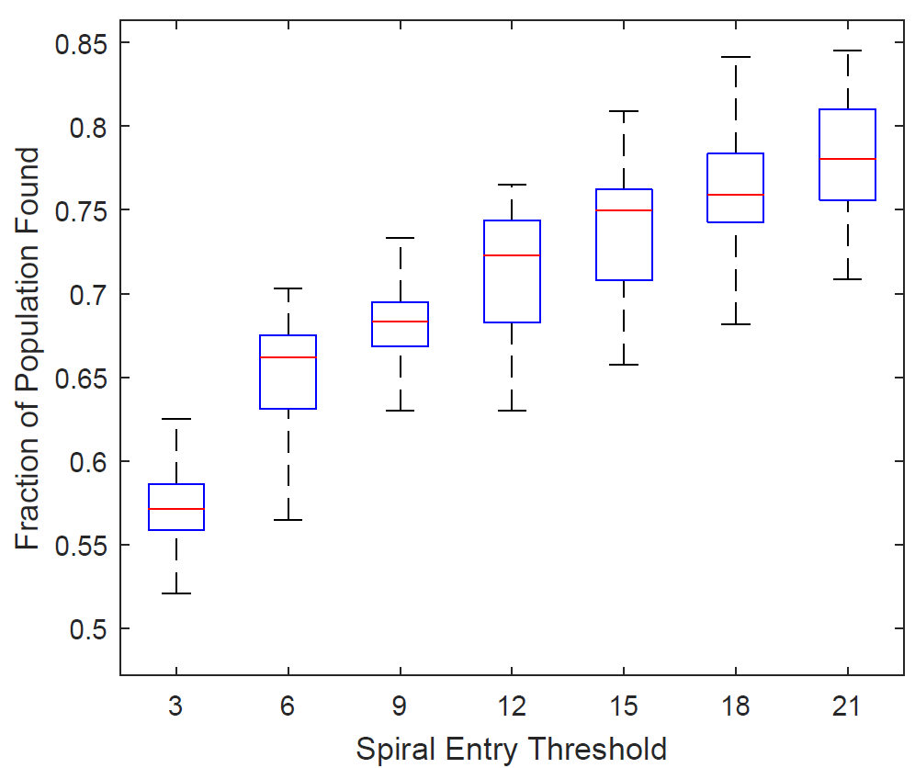
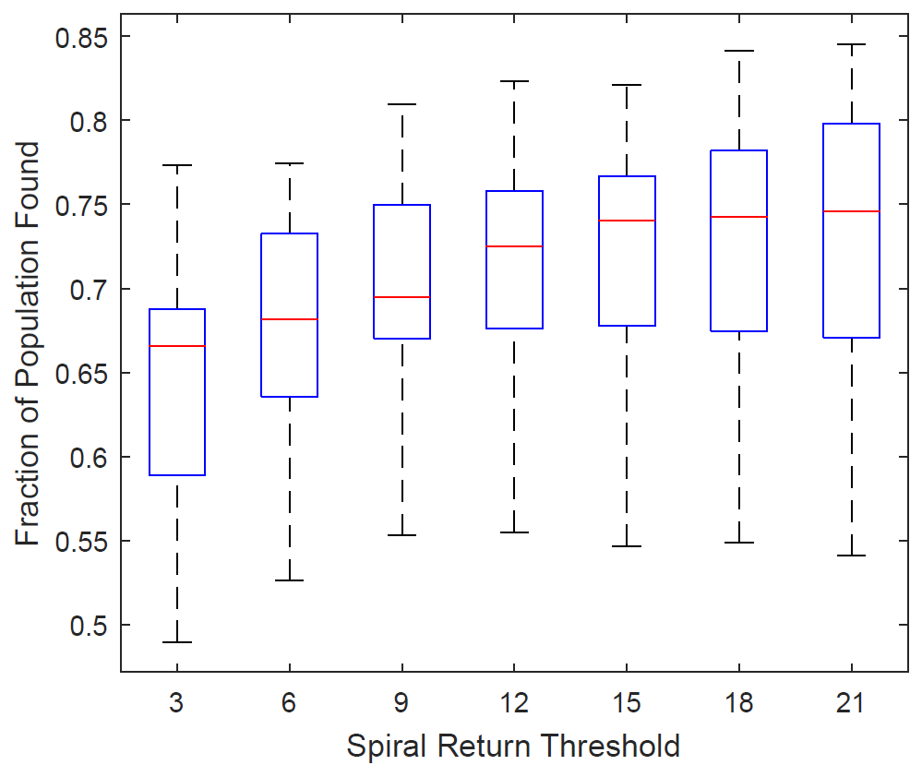
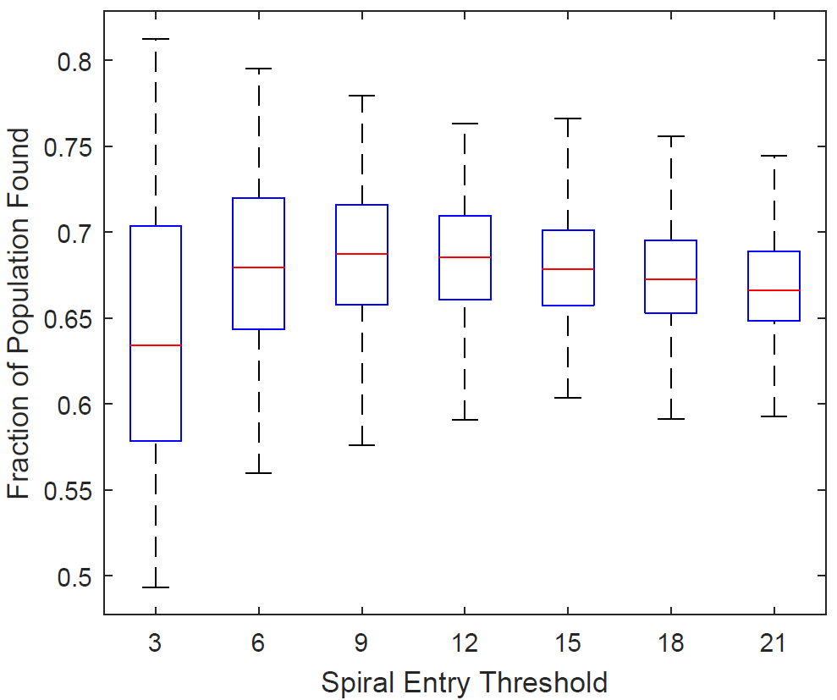
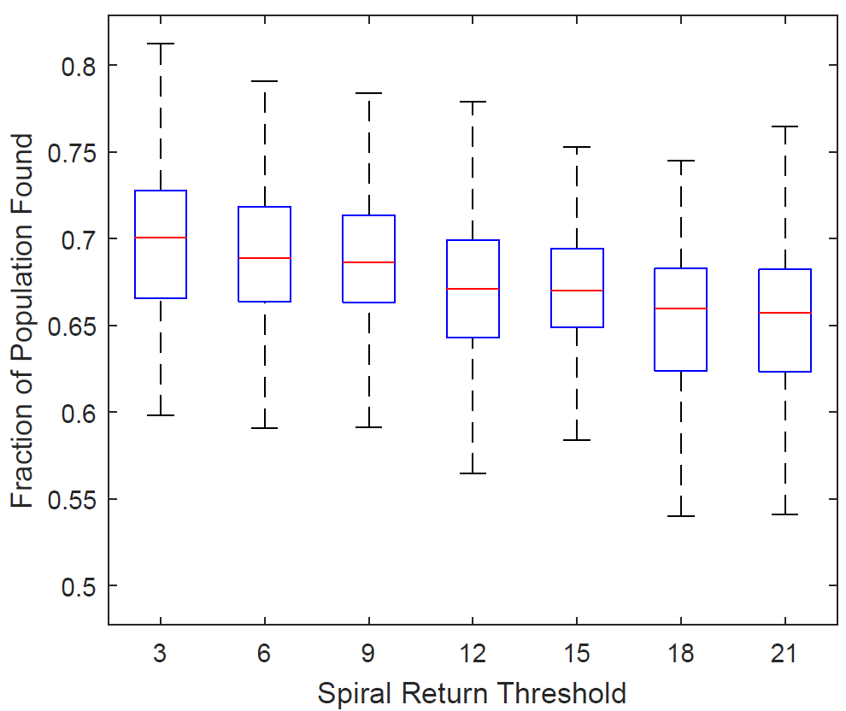
Spiral Thresholds
Boustrophedon
Setpoints:
10 to enter Spiral
10 to return to Base
Random Bounce
Setpoints:
9 to enter Spiral
3 to return to Base

Slide 16
Simulations
Test T = 900 s (enough time for full spatial coverage) and T = 300 s (insufficient time for full coverage)
Run 100 trials of each path
Compare results for spatial coverage and population coverage

Slide 17
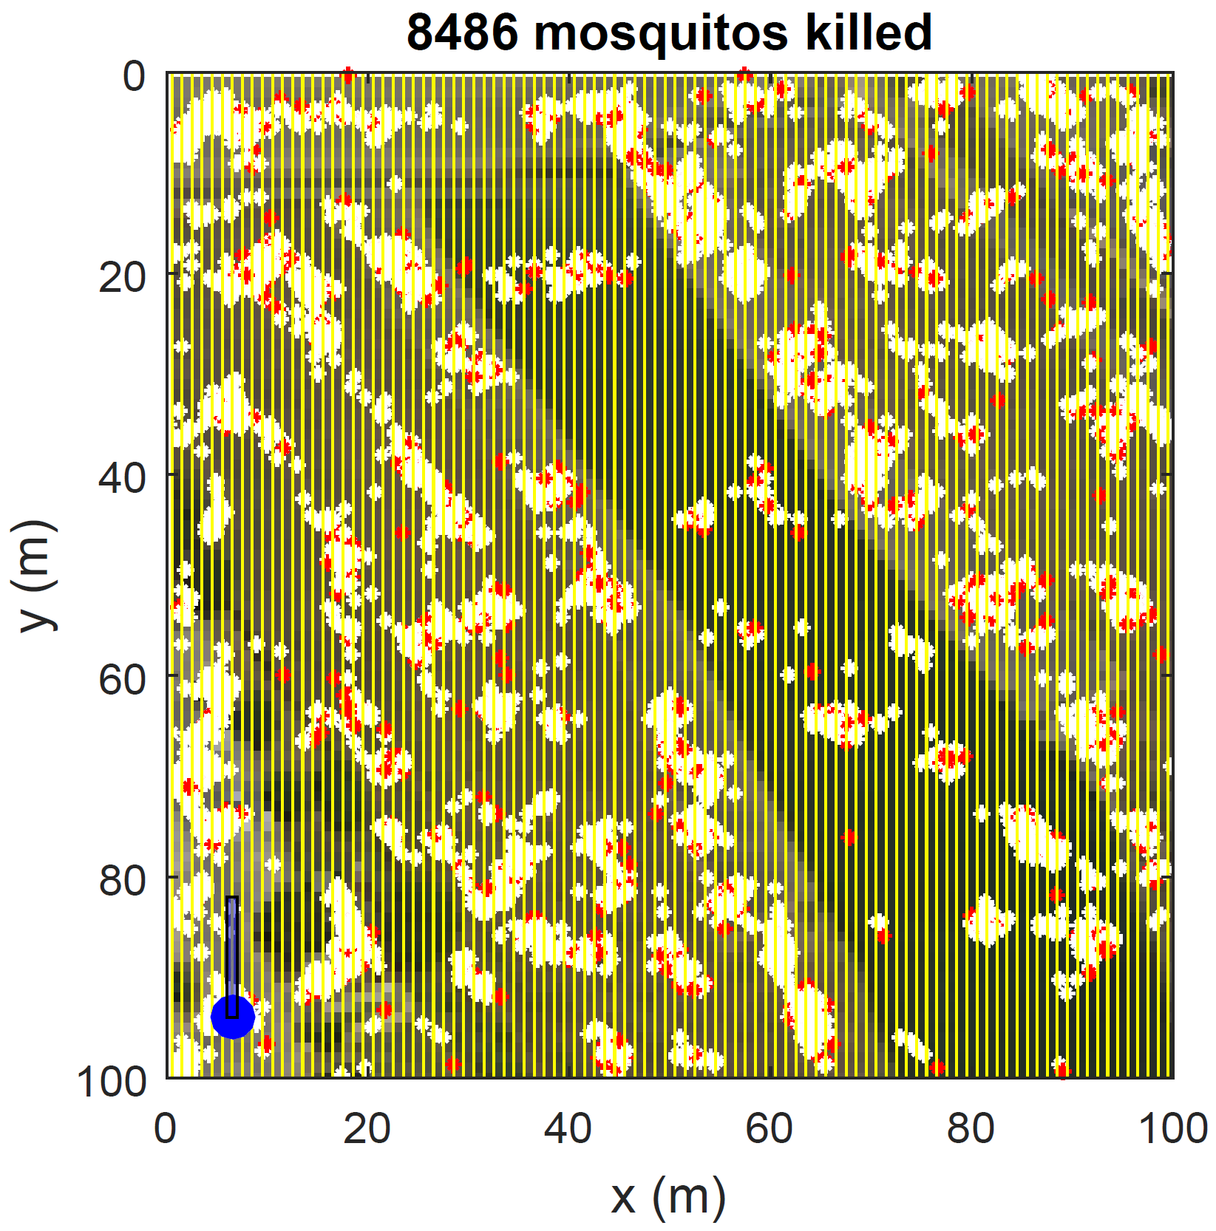
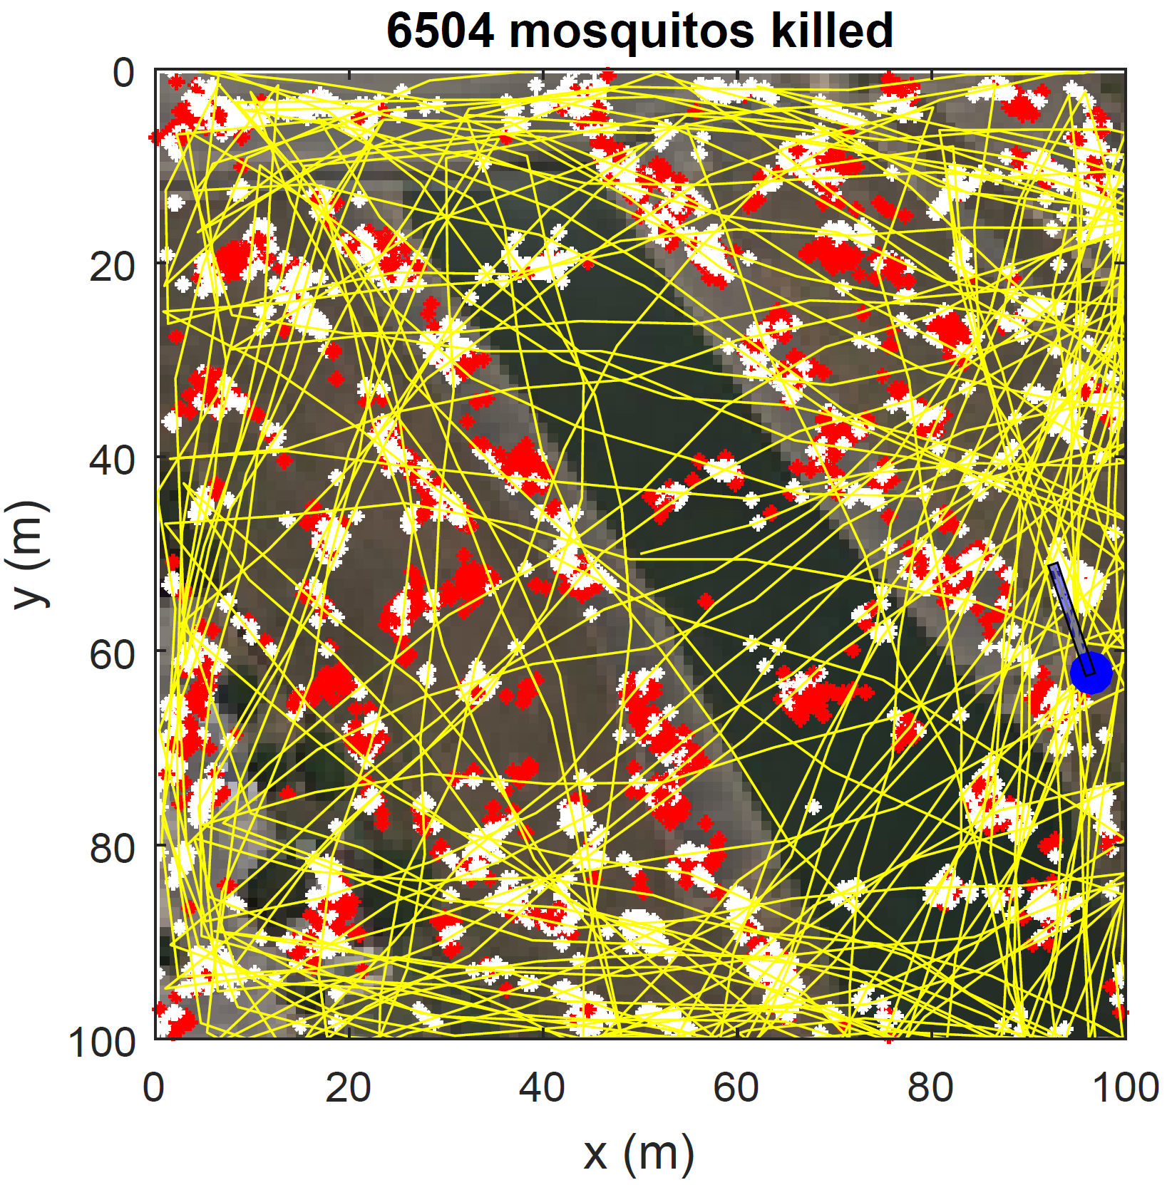
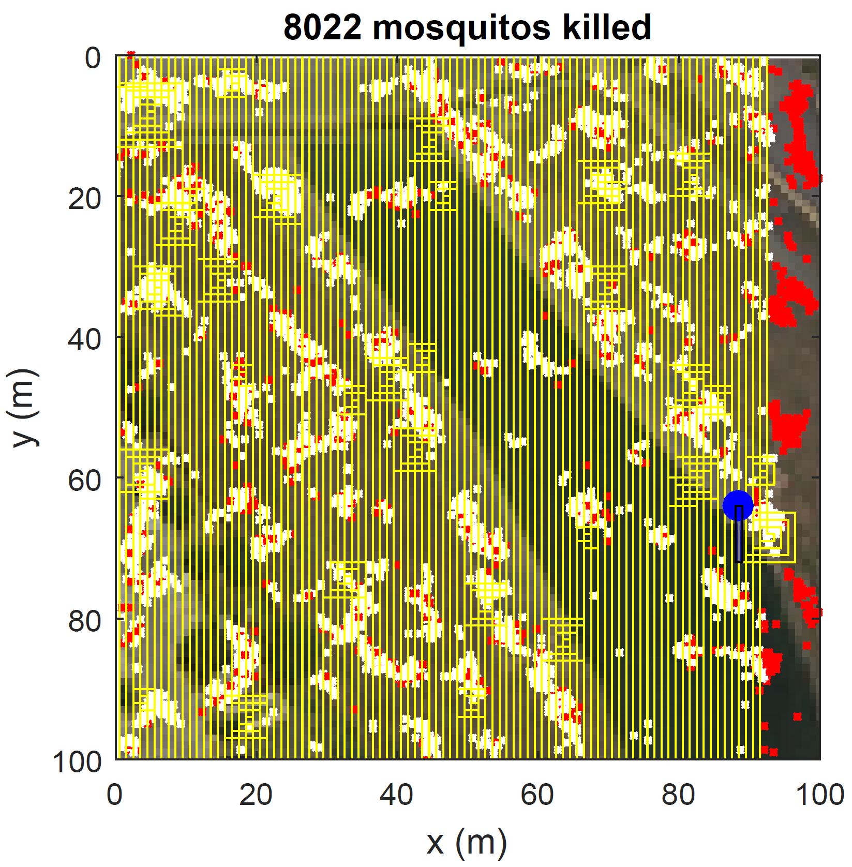
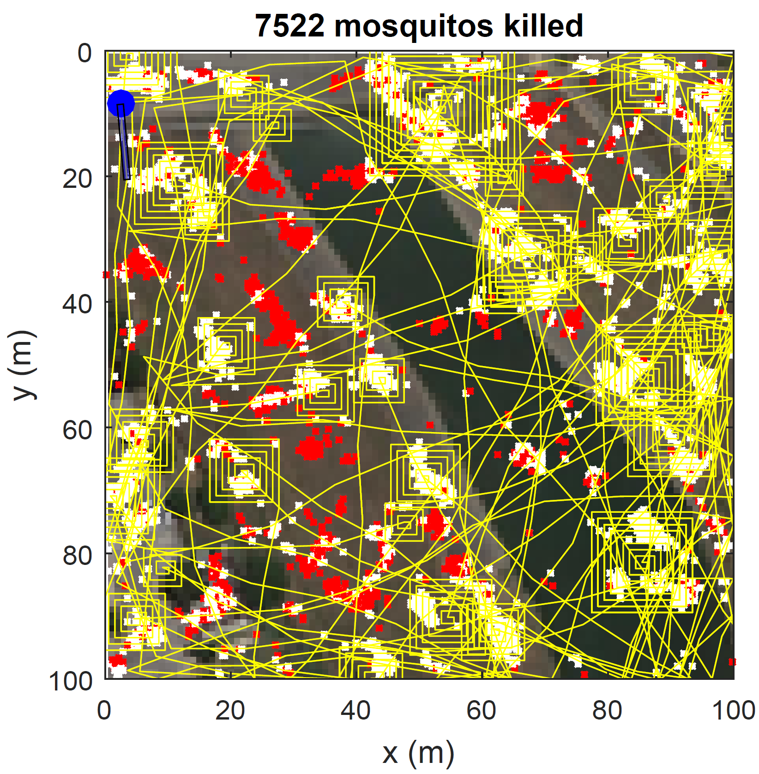
Paths for T=900 s
Boustrophedon
Random Bounce
Boustrophedon covers whole field
Boustrophedon with spiral does not cover whole field
Spiral with random bounce gives more population-focused coverage
Boustrophedon/Spiral
Random Bounce/Spiral

Slide 18
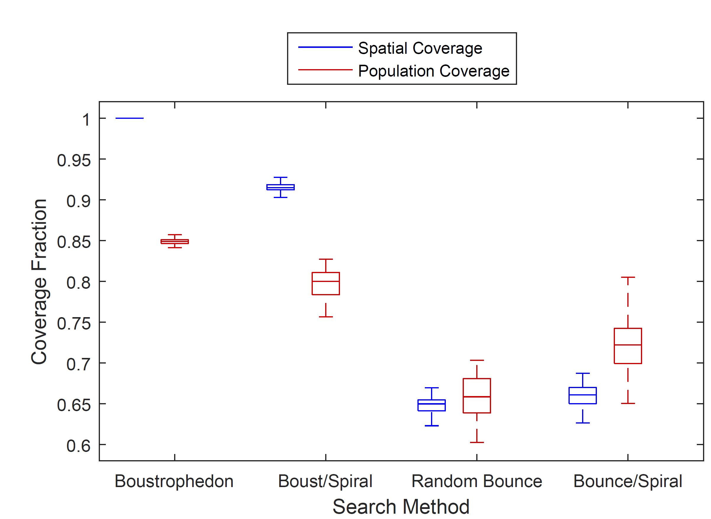
Comparison for T=900 s
Boustrophedon: μ=84.9%, σ=0.4%
Boustrophedon/ Spiral: μ=79.8%, σ=1.7%
Random bounce: μ=65.9%, σ=2.5%
Random bounce/ Spiral: μ=71.9%, σ=3.8%

Slide 19
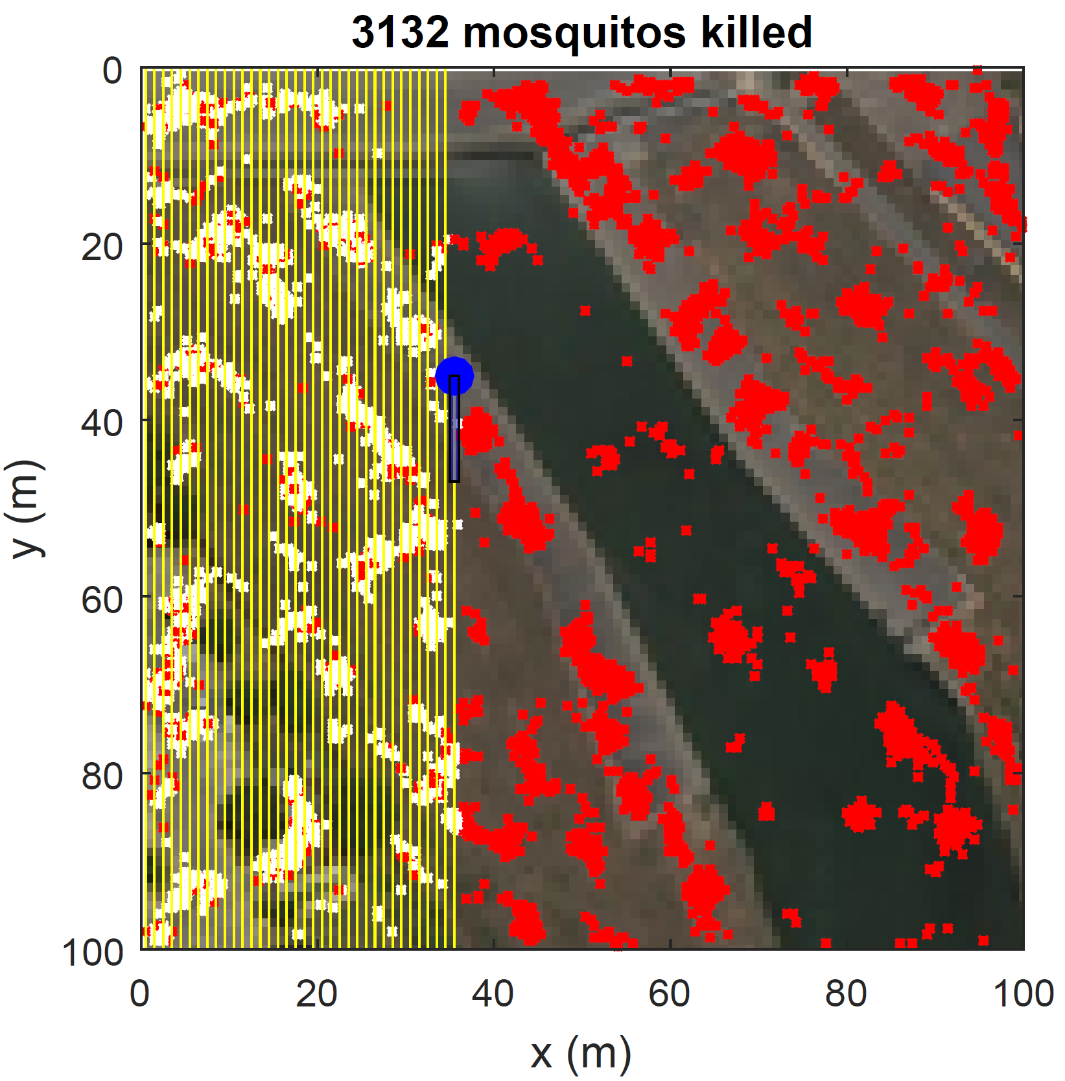
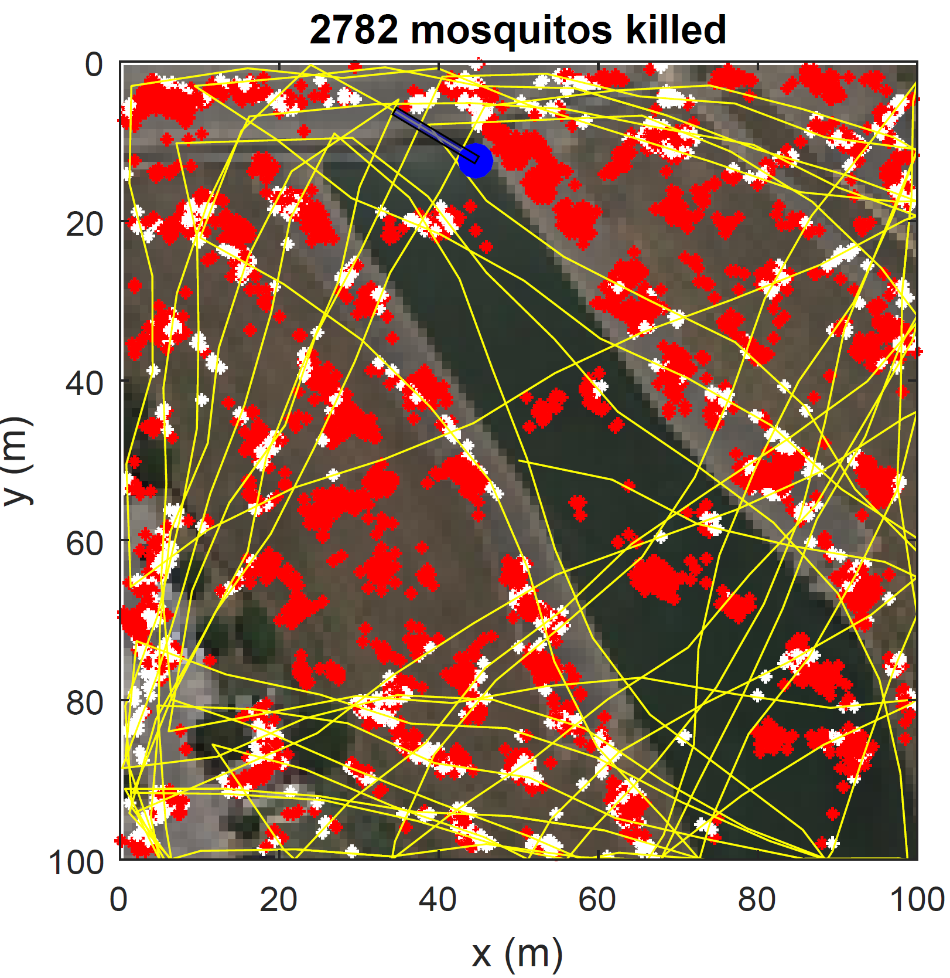
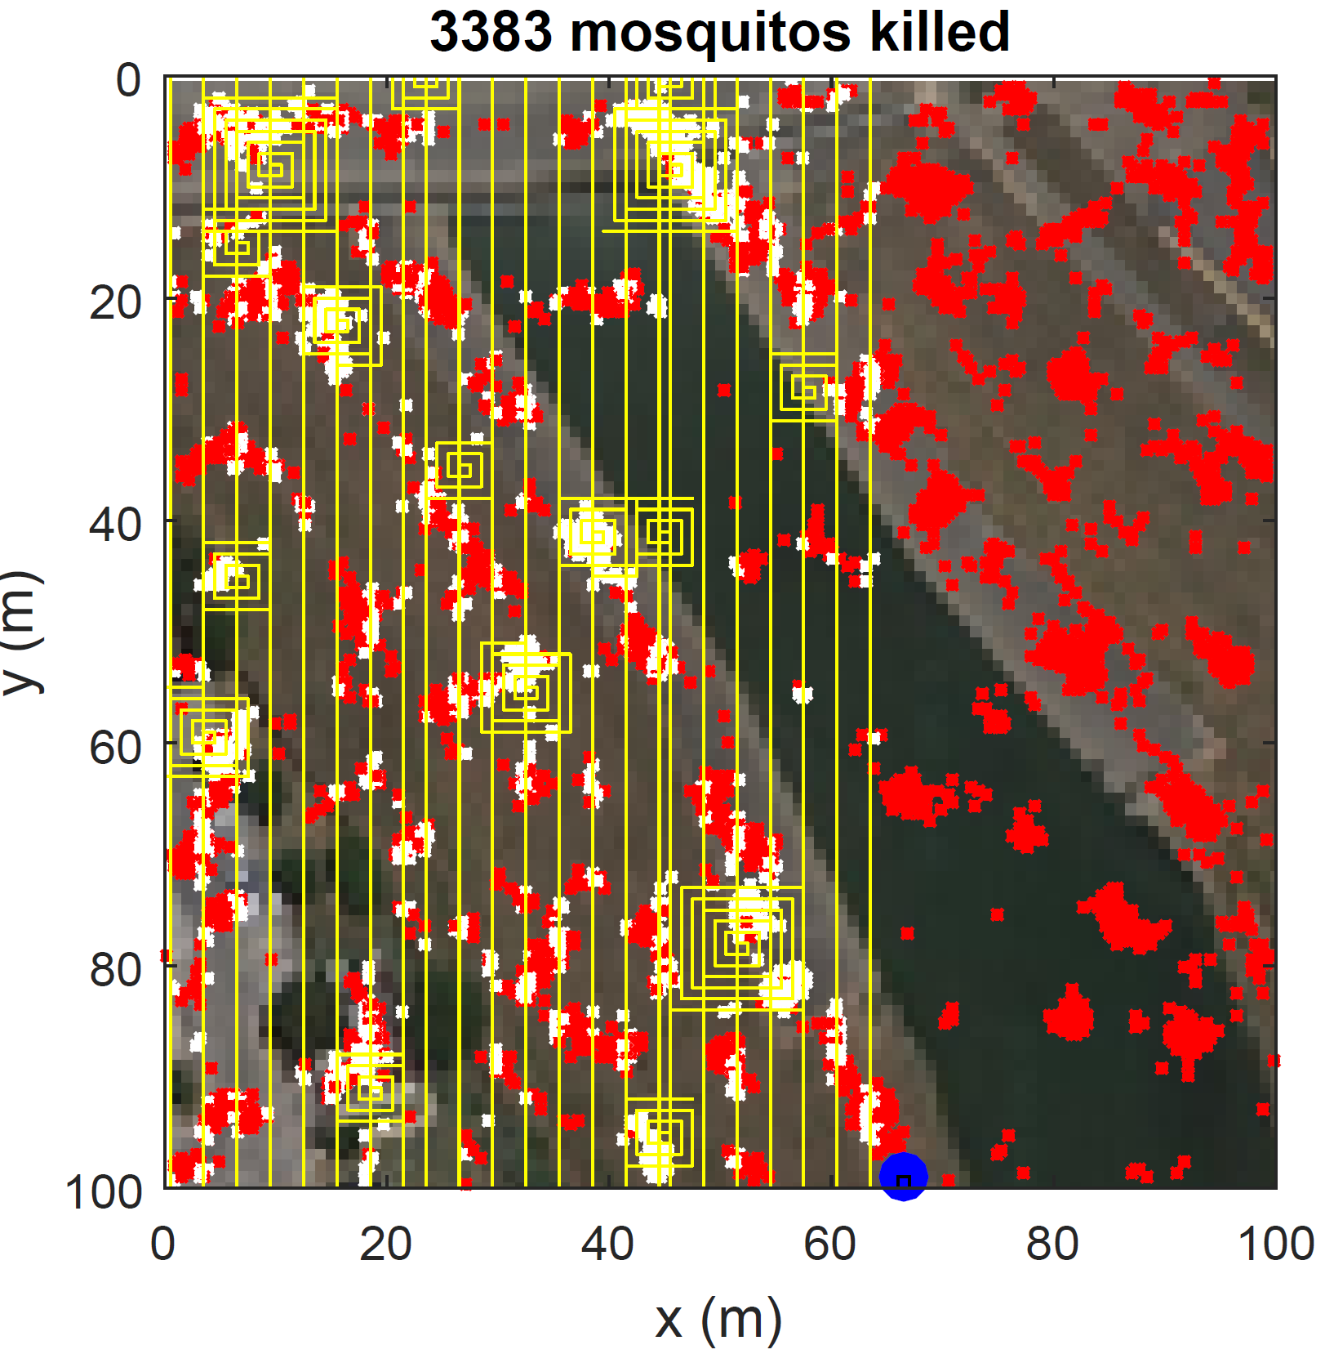
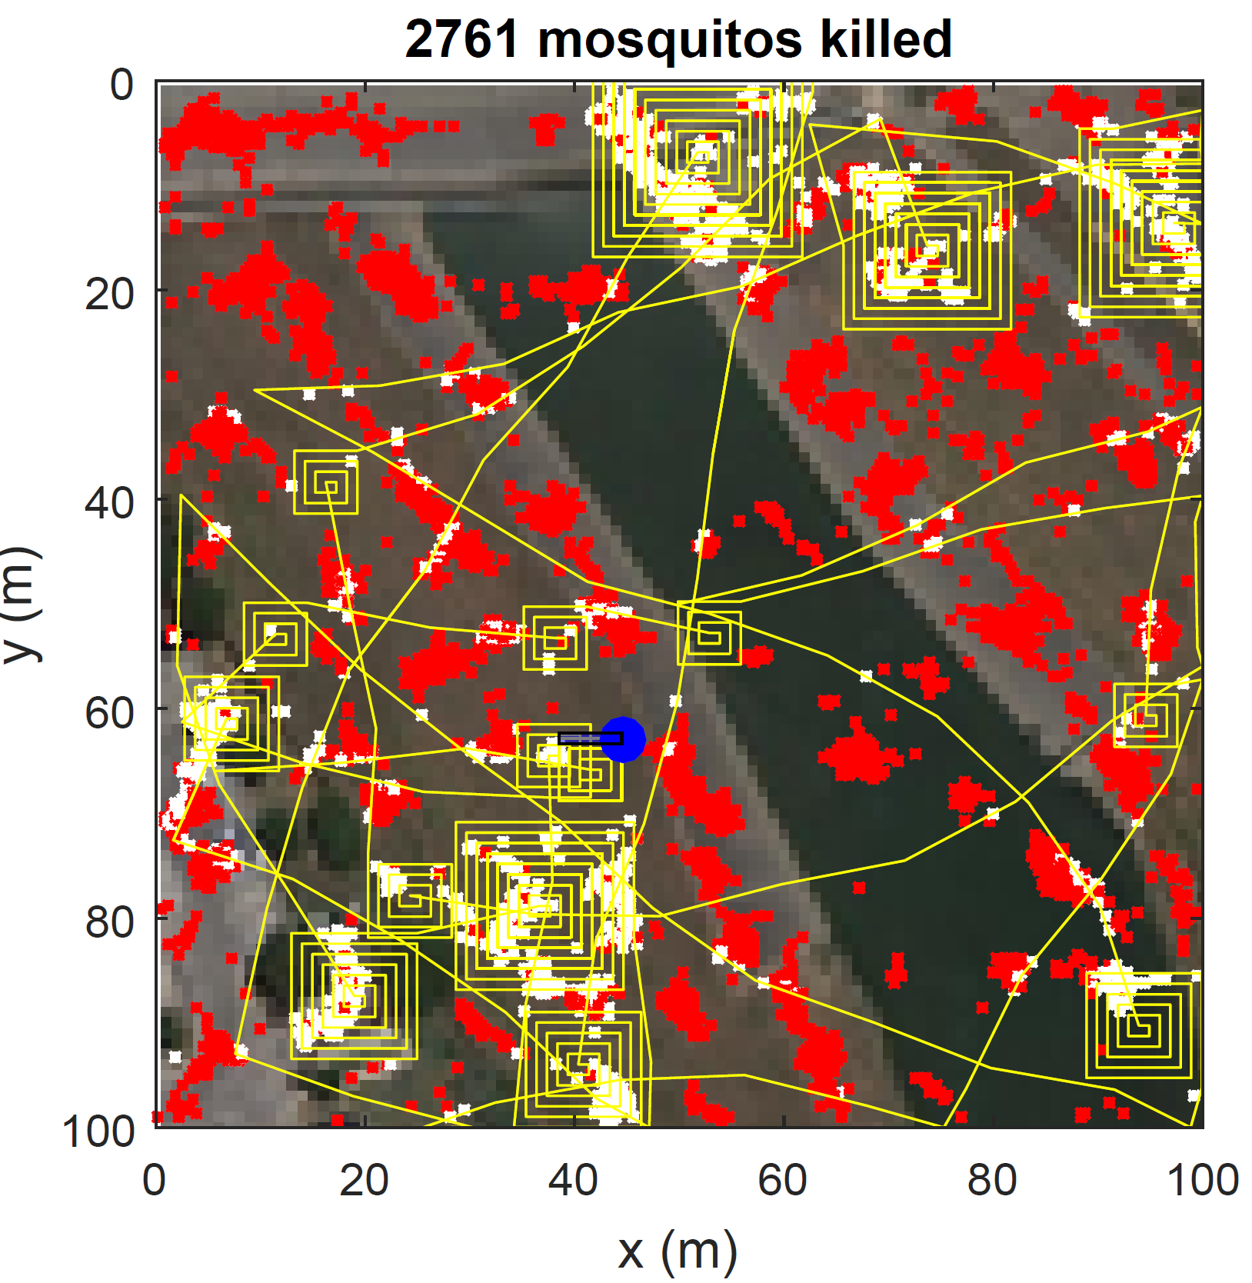
Paths for T=300 s
Boustrophedon
Random Bounce
Boustrophedon covers a small solid area
Boustrophedon with spiral using a wider spacing to give more even coverage
Random bounce with spiral dwells in high population areas
Boustrophedon/Spiral
Random Bounce/Spiral

Slide 20
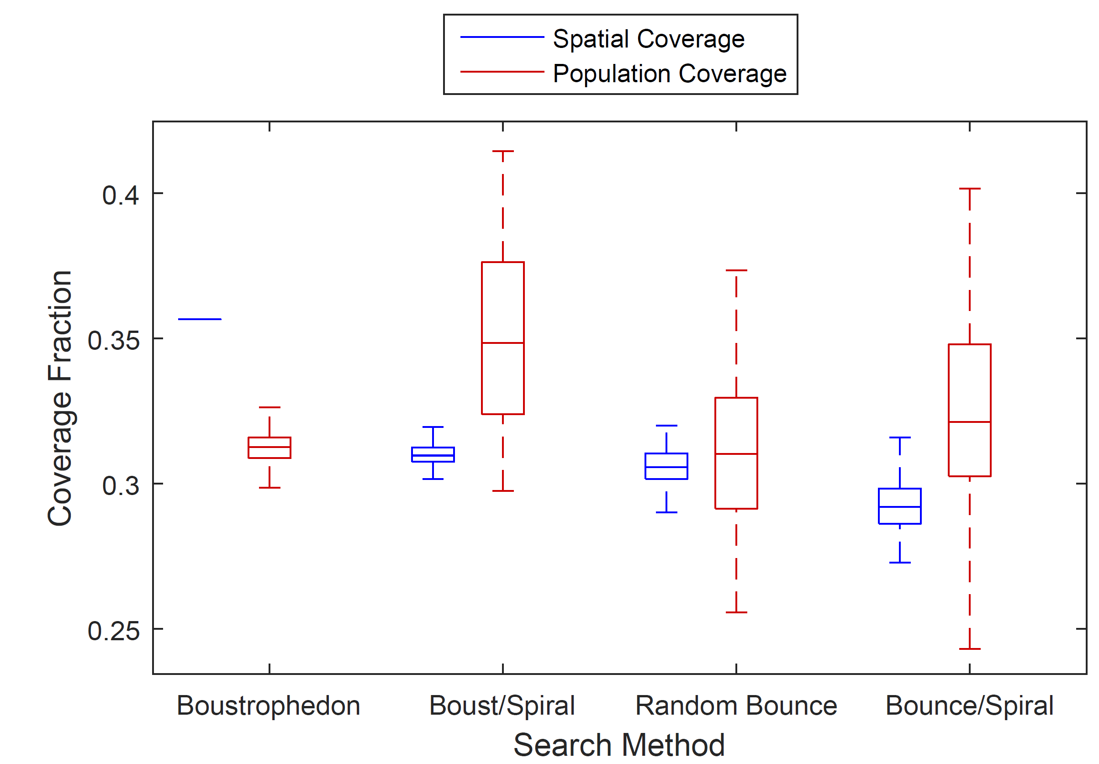
Comparison for T=300 s
Boustrophedon: μ=31.2%, σ=0.5%
Boustrophedon/ Spiral: μ=35.0%, σ=3.0%
Random bounce: μ=31.2%, σ=2.8%
Random bounce/ Spiral: μ=32.5%, σ=3.5%

Slide 21
Results
When there is time to cover the whole space, full spatial coverage gives the best population coverage
When there is not time to cover the whole space, a policy that dwells in high population areas is better than pure spatial coverage

Slide 22
Difficulties with Approach
Simulating individuals gives a very noisy stochastic process
Many iterations are required to find the usual performance for a given set of parameters
Any parameter changes require lengthy reevaluation

Slide 23
Extension and Generalization
Generalize the movement of the population from individuals to probability distribution functions
Divide the workspace into cells with a probability of containing a particle
Treat the motion of particles between cells as a Markov process

Slide 24
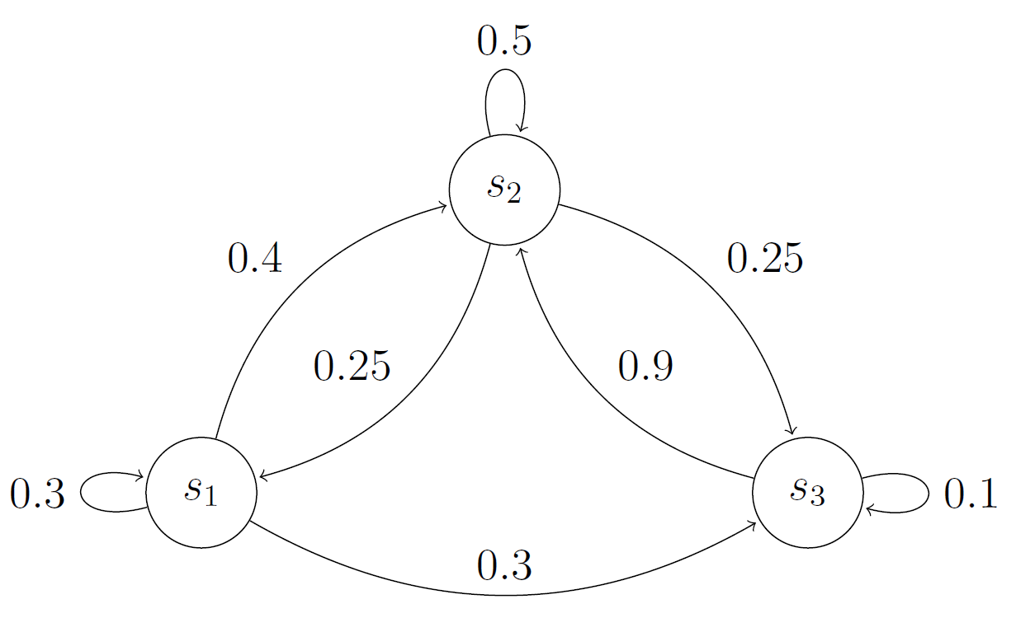
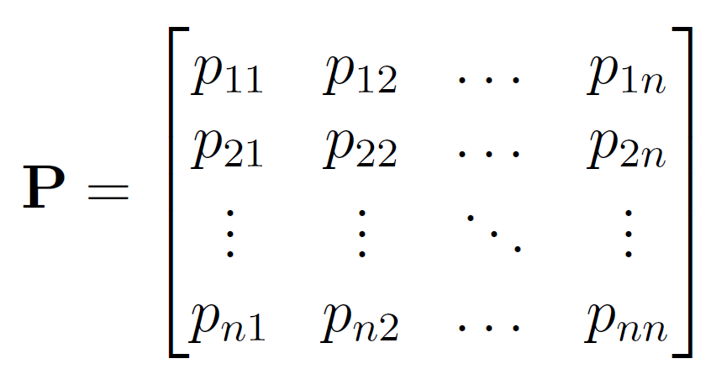
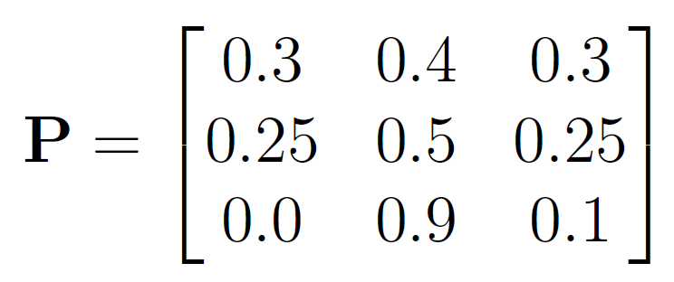
Markov Processes
Series of events with a probabi- lity of moving from one state to another at each step
Probabilities depend only on the current state, not the past
Build a transition matrix

Slide 25
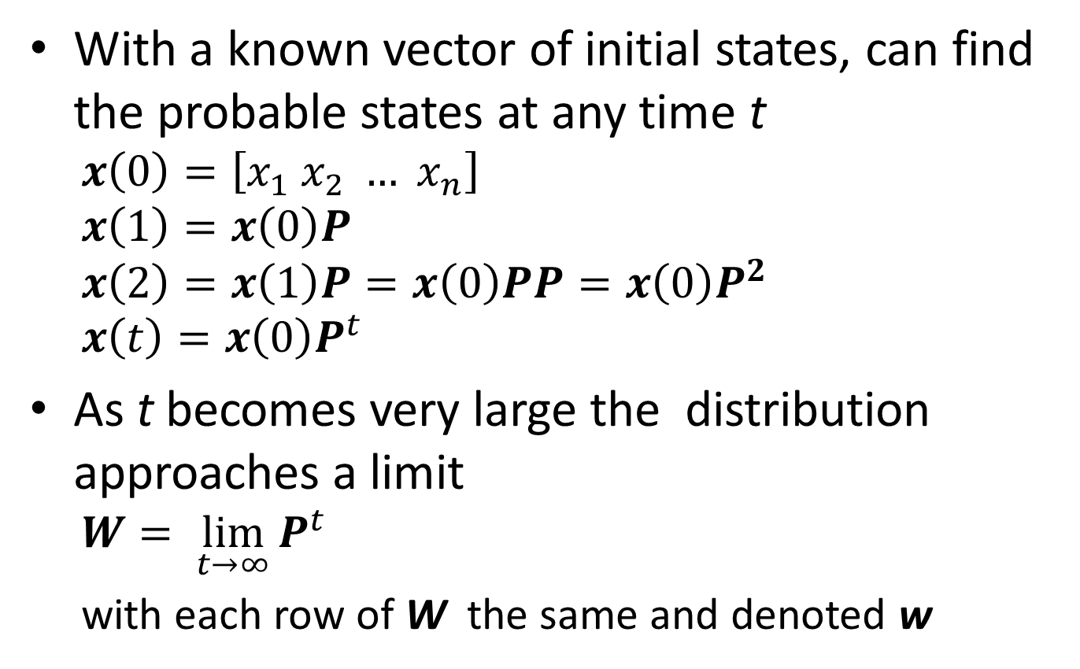
Markov Processes (con’t)
With a known vector of initial states, can find the probable states at any time t
$$x\left(0\right)=\left[x_{1} x_{2} … x_{n}\right]$$
$$x\left(1\right)=x\left(0\right)P$$
$$x\left(2\right)=x\left(1\right)P=x\left(0\right)PP=x\left(0\right)P^{2}$$
$$x\left(t\right)=x\left(0\right)P^{t}$$
As t becomes very large the distribution approaches a limit
$$W= \lim_{t→∞}{P^{t}}$$
with each row of W the same and denoted w

Slide 26
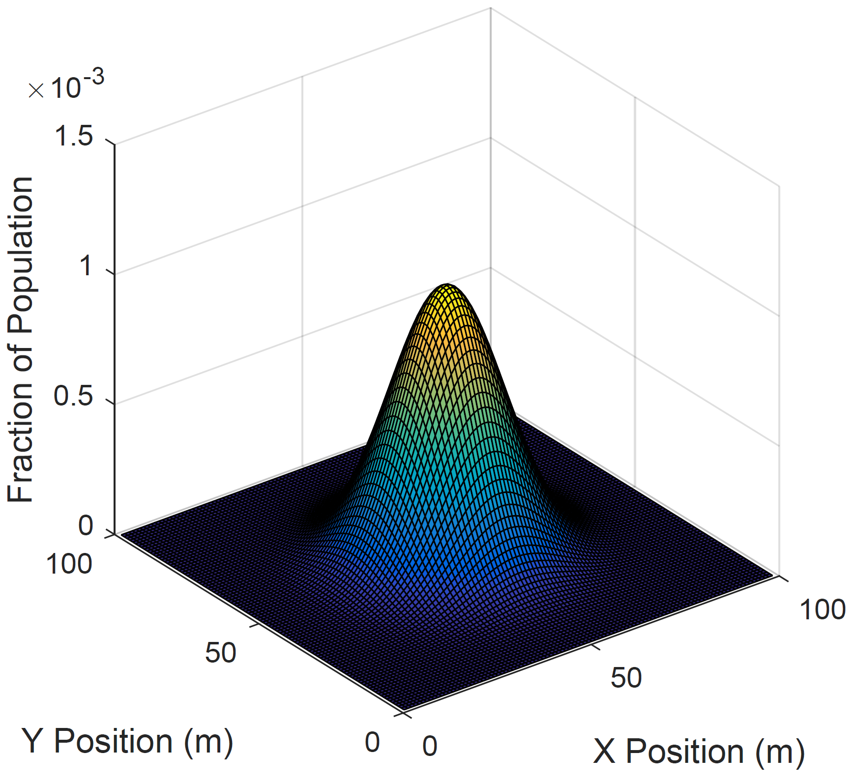
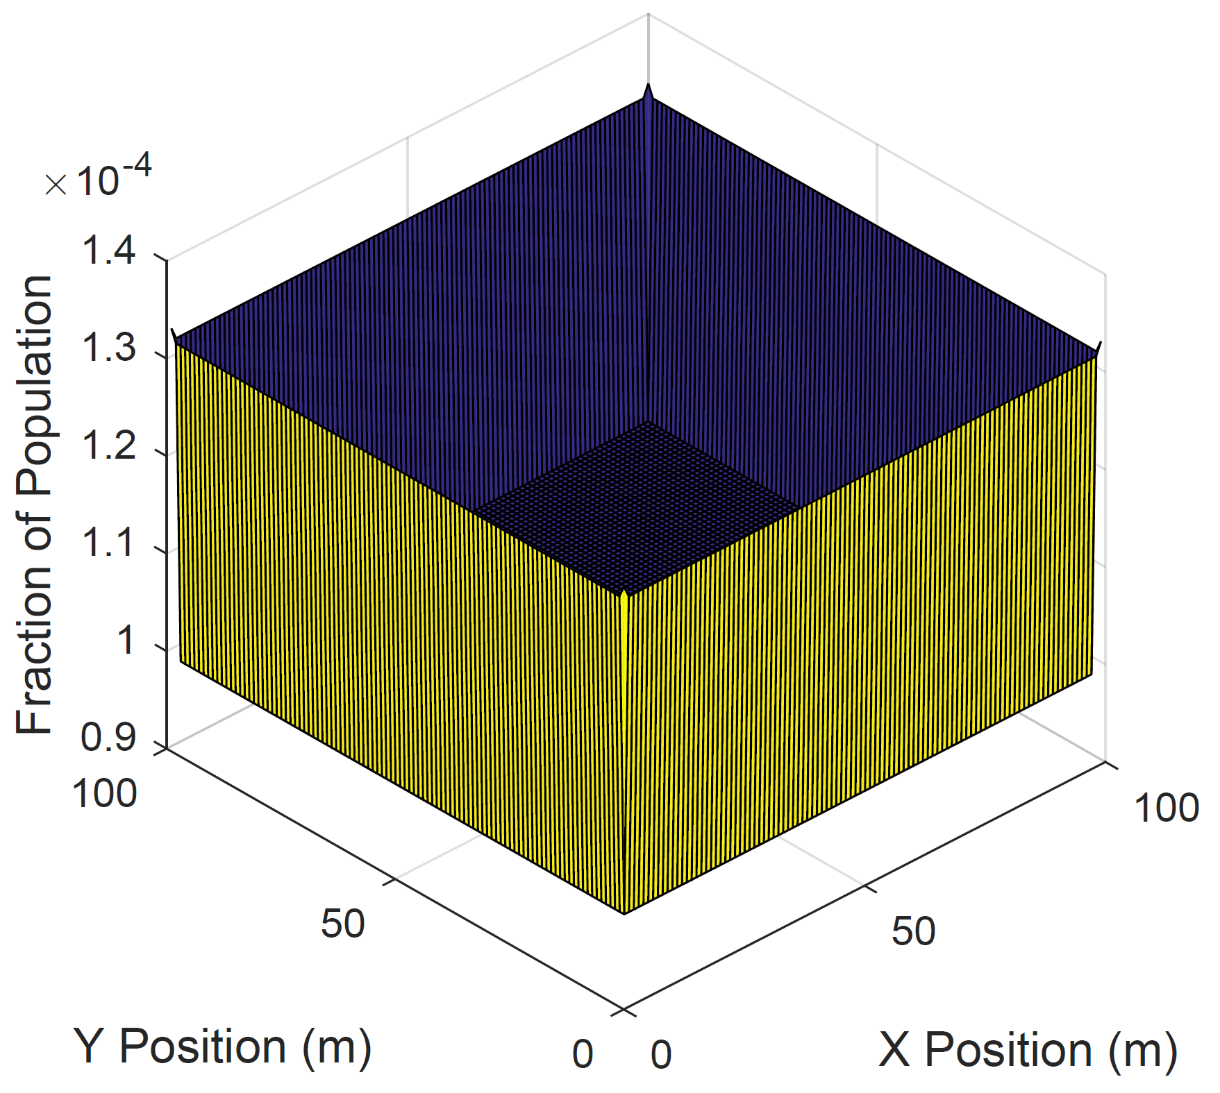
Environments for Exploration
Uniform Distribution with Sticky Walls
Normal Distribution

Slide 27
Uniform Distribution with Sticky Walls
Square workspace with boundary walls
Begin with a uniform distribution
Particles in edge cells are more likely to stay in edge cells than move away from edges
Reduction in probability is called a sticking factor s

Slide 28
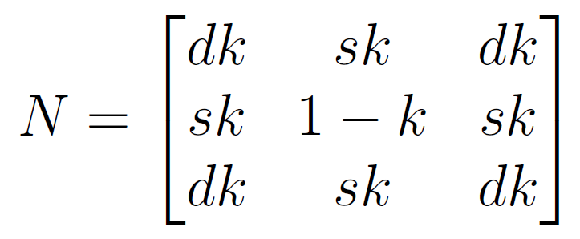
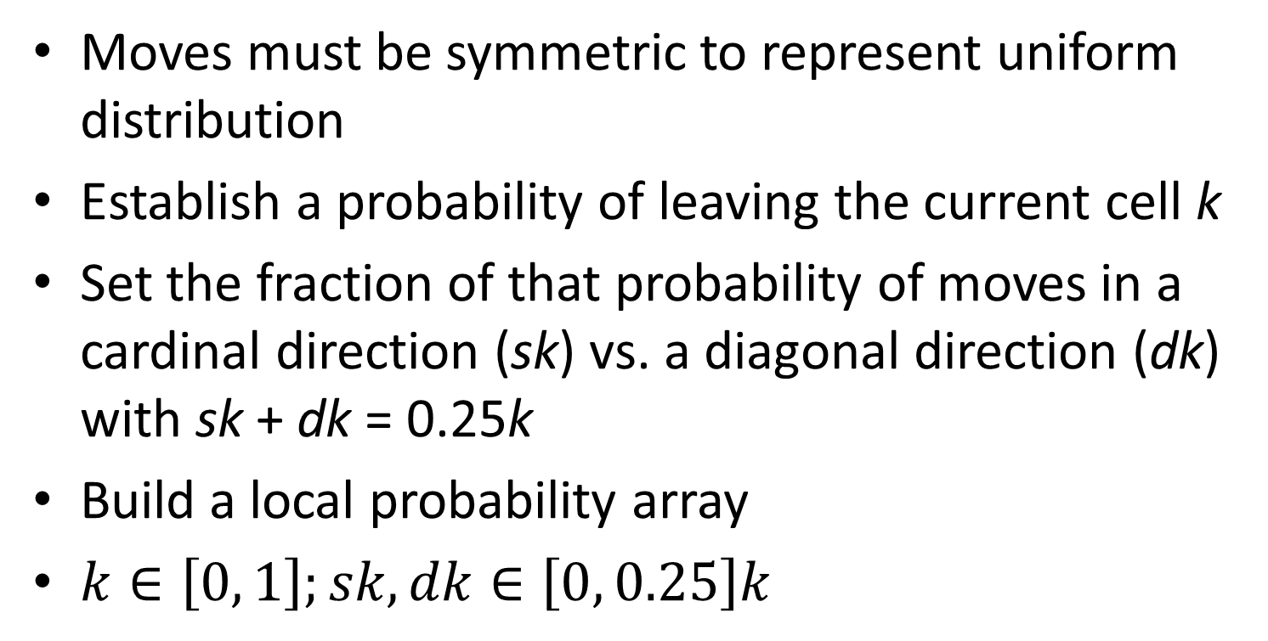
Building the Transition Matrix
Moves must be symmetric to represent uniform distribution
Establish a probability of leaving the current cell k
Set the fraction of that probability of moves in a cardinal direction (sk) vs. a diagonal direction (dk) with sk + dk = 0.25k
Build a local probability array
$k∈\left[0, 1\right];sk,dk∈\left[0, 0.25\right]k$

Slide 29
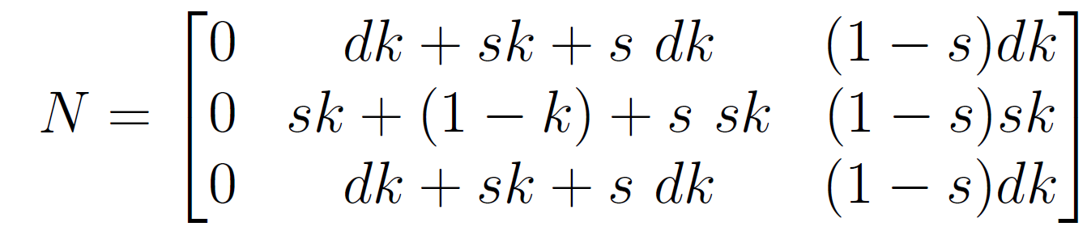
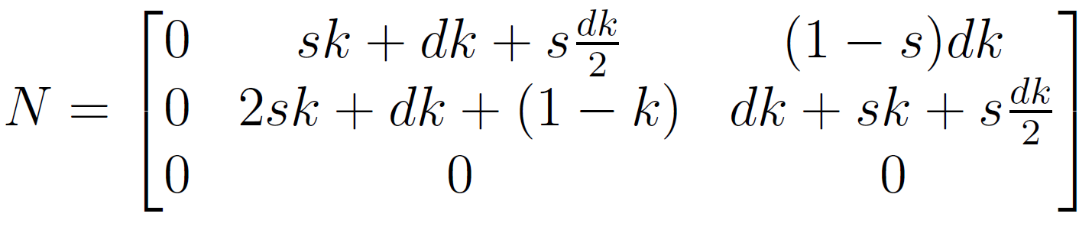
Building the Transition Matrix (con’t)
Fold array at edges and corners
Apply sticking coefficient
Fill P from N arrays

Slide 30
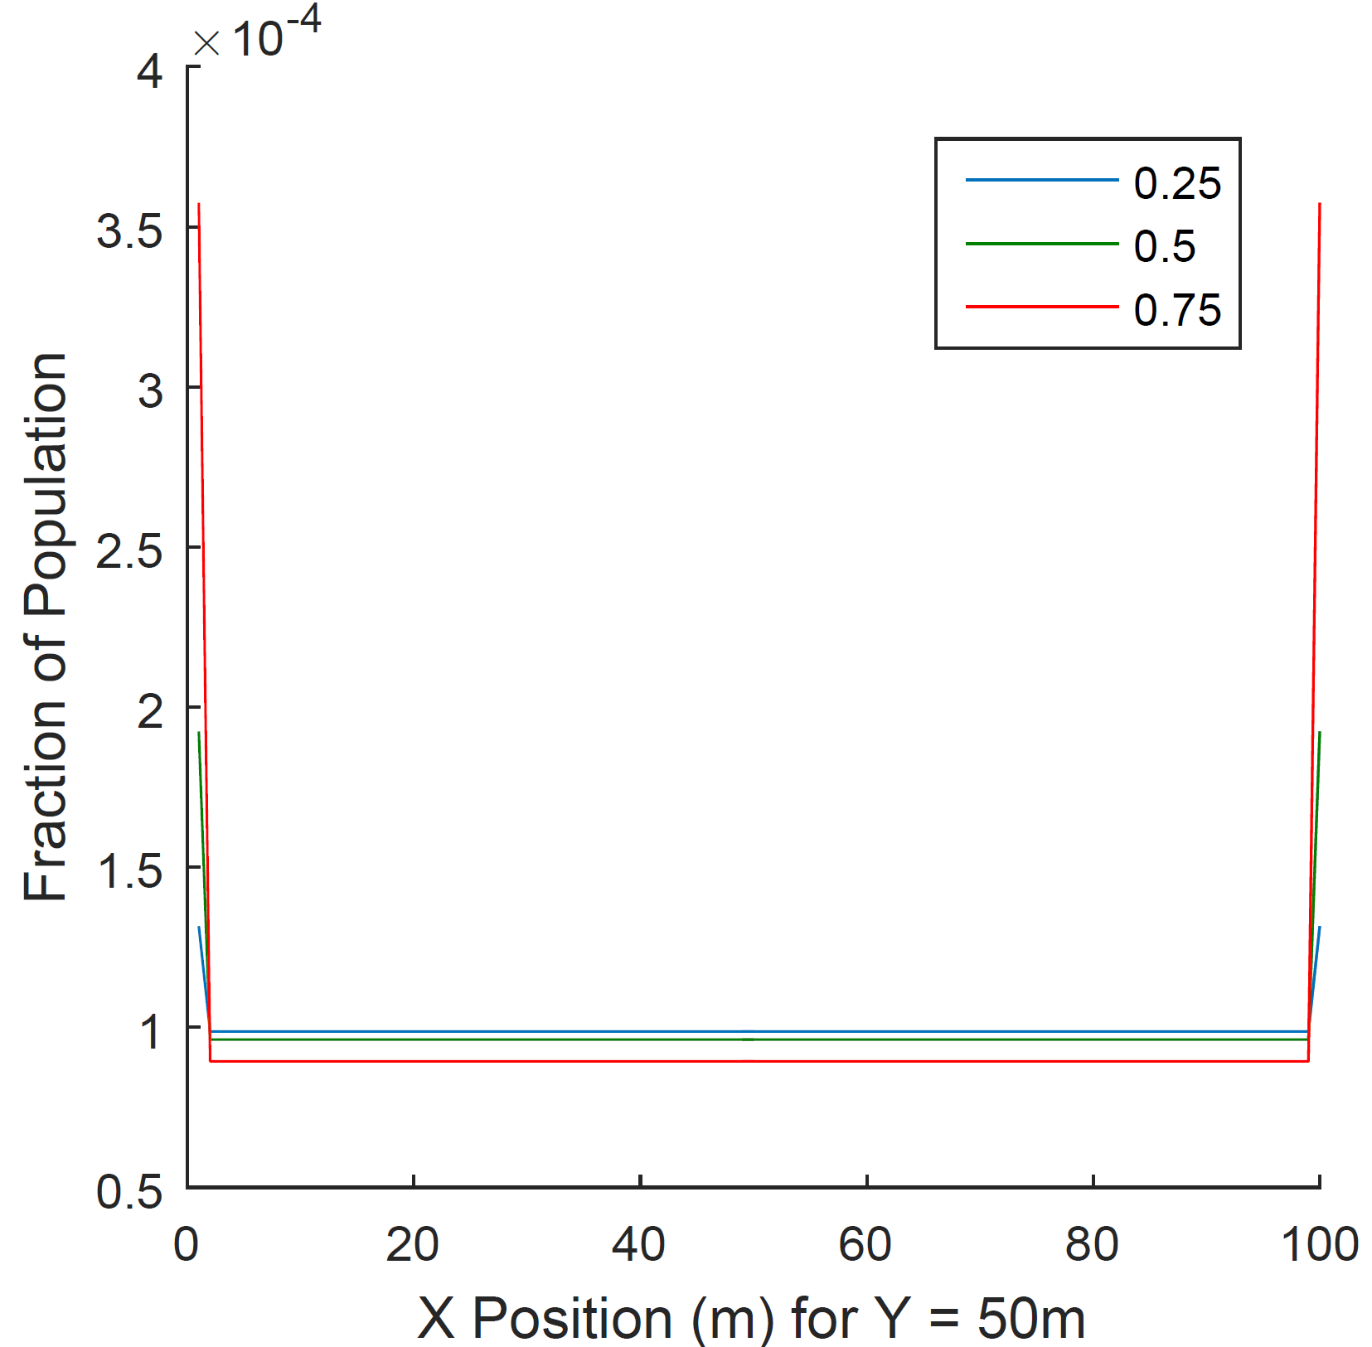
Sticky Wall Stationary Distribution
Shape of distribution
Depth depends on s

Slide 31
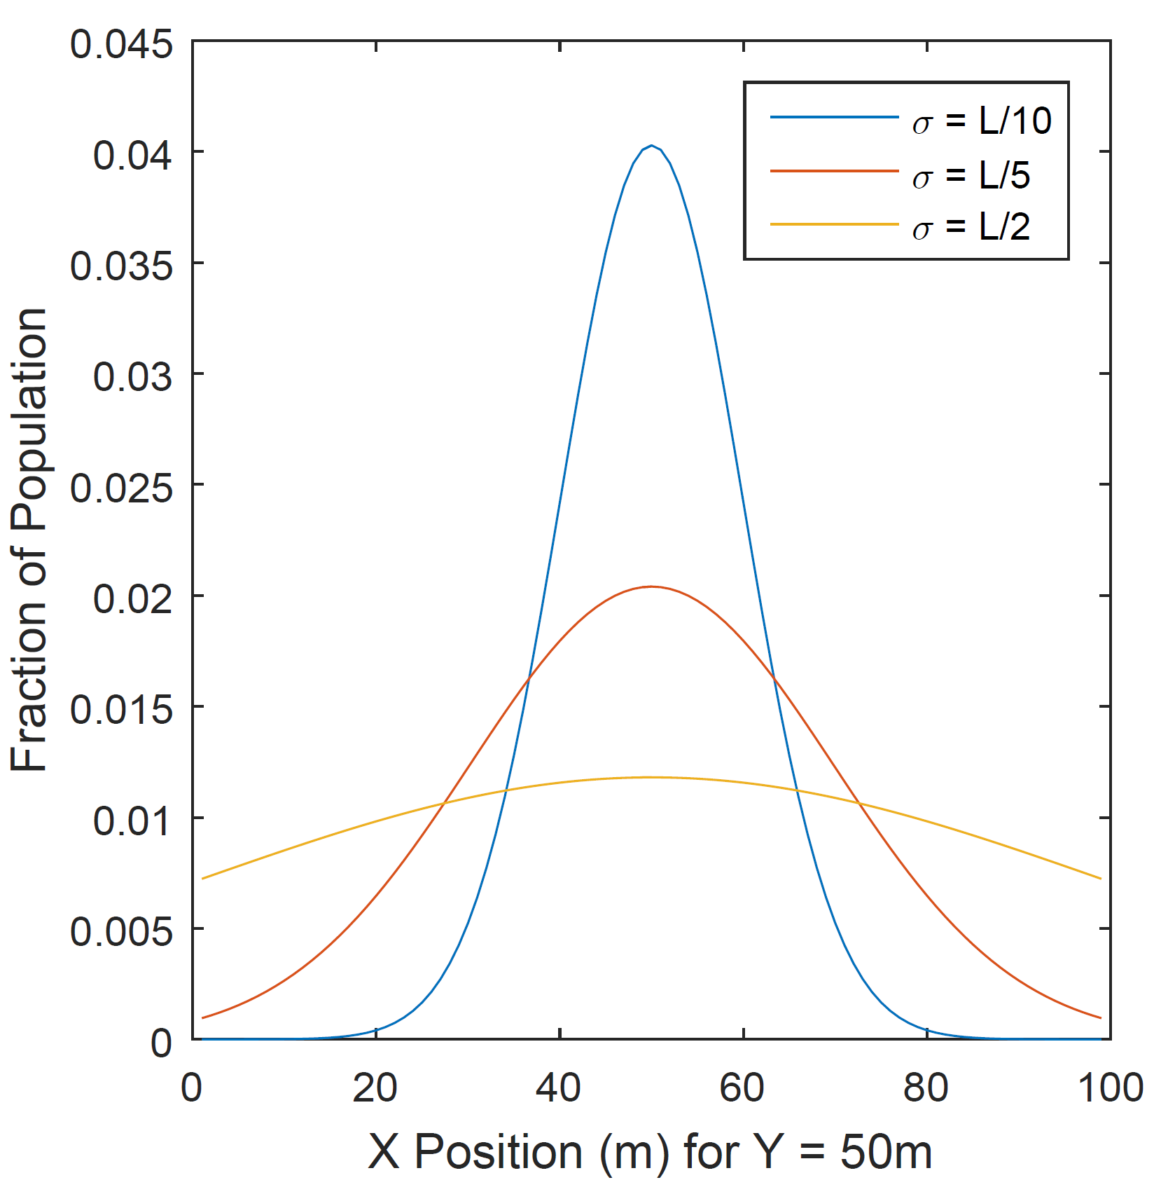
Normal Distribution
Square workspace without walls
Center has something that attracts particles
Particles form a 2-D normal distribution
μ in center, σ variable

Slide 32
Building the Transition Matrix
Split distribution into two independent 1-D normal distributions
Use cumulative distribution function to set stationary distribution for each cell within bounds and normalize
Stationary distribution is not unique to a transition matrix so build a linear programming problem from the constraints

Slide 33
Linear Programming Problem
Matlab function linprog
Solve Ax=B for x subject to limit and minimization criteria
Set x for values in P matrix
Build A matrix and B vector from problem constraints

Slide 34
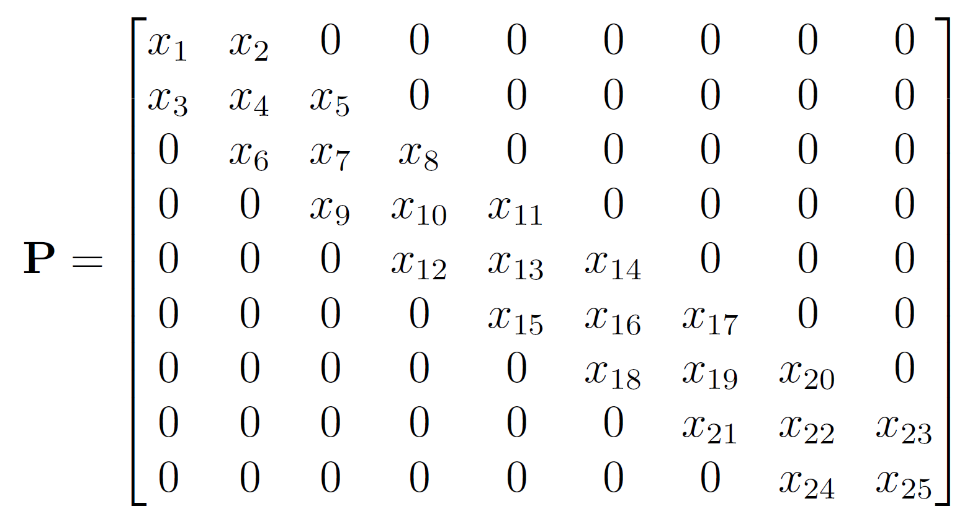
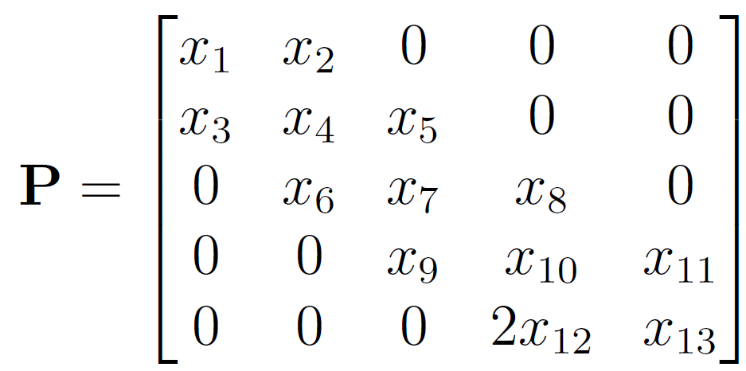
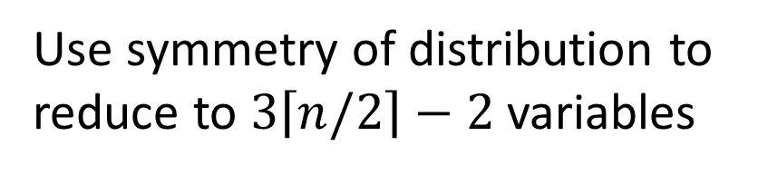
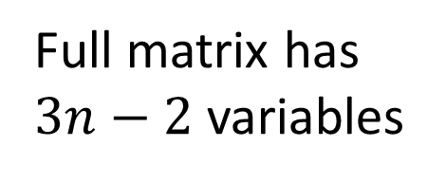
Selecting Variables
Full matrix has $3n−2$ variables
Use symmetry of distribution to reduce to $3\left\lceil n/2\right\rceil −2$ variables

Slide 35
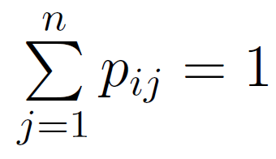
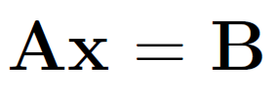
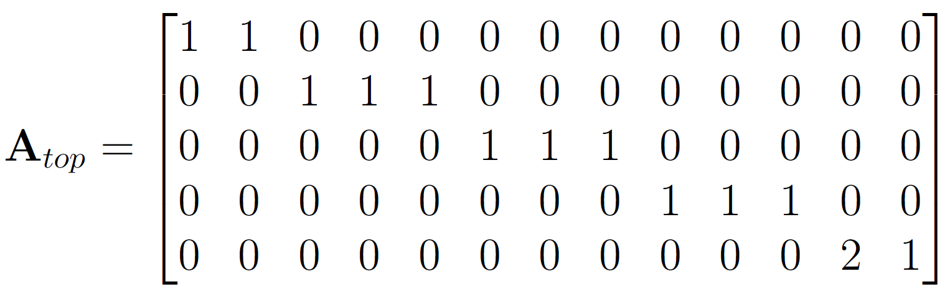
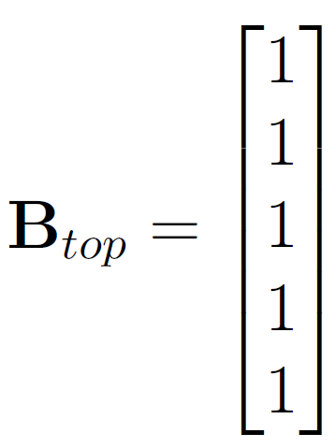
Linear Programming Problem Probability Constraints

Slide 36
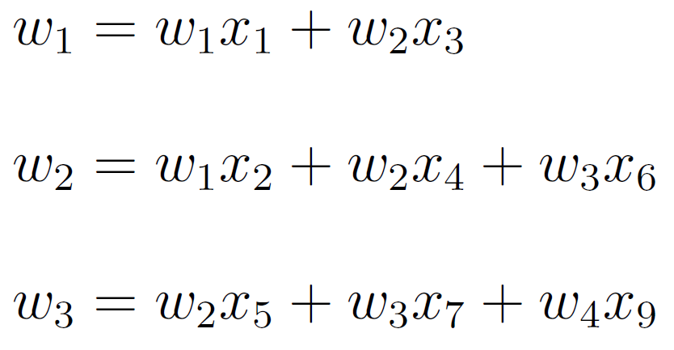
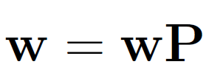
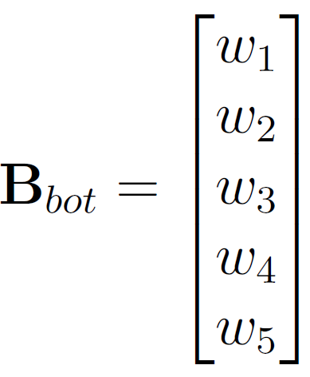
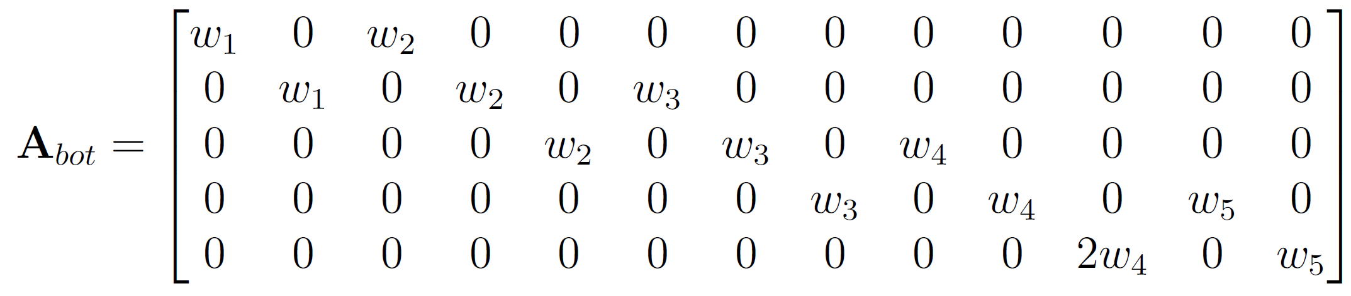
Linear Programming Problem Stationary Distribution Constraints

Slide 37
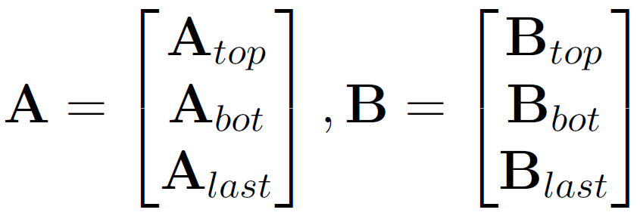
Linear Programming Problem Diffusion Constraint and Options
Diffusion rate constraint – probability k of leaving the center cell
Lower limit for all values: 0
Upper limit for all values: 1
Minimization criteria: Use all values
Solve Ax = B with

Slide 38
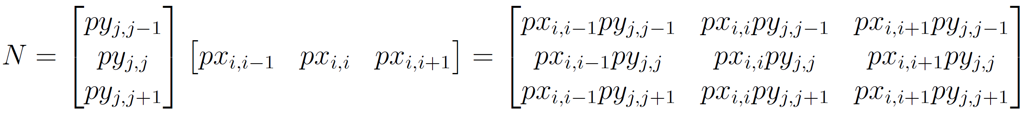
Linear Programming Problem Solution
Apply symmetry to fill other half of matrix
Solve problem in each dimension and multiply to extend to 2-D
Fill P matrix

Slide 39
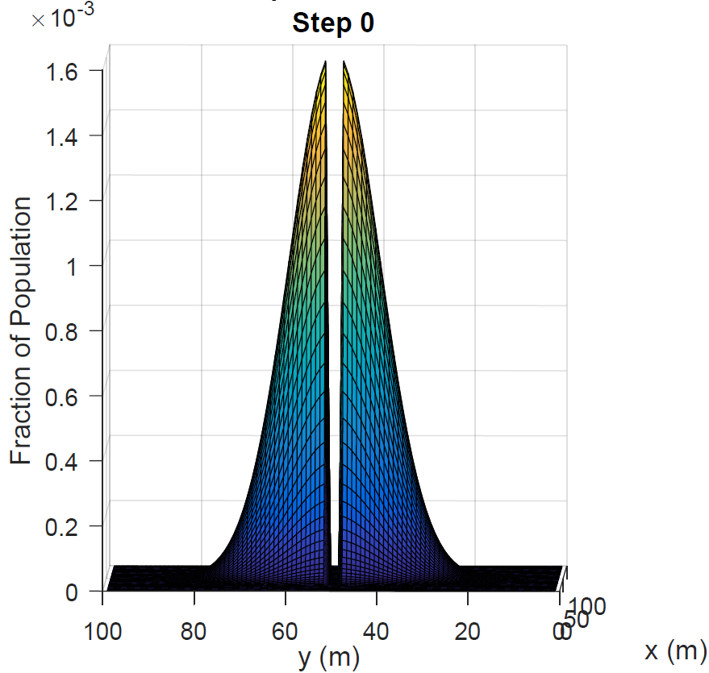
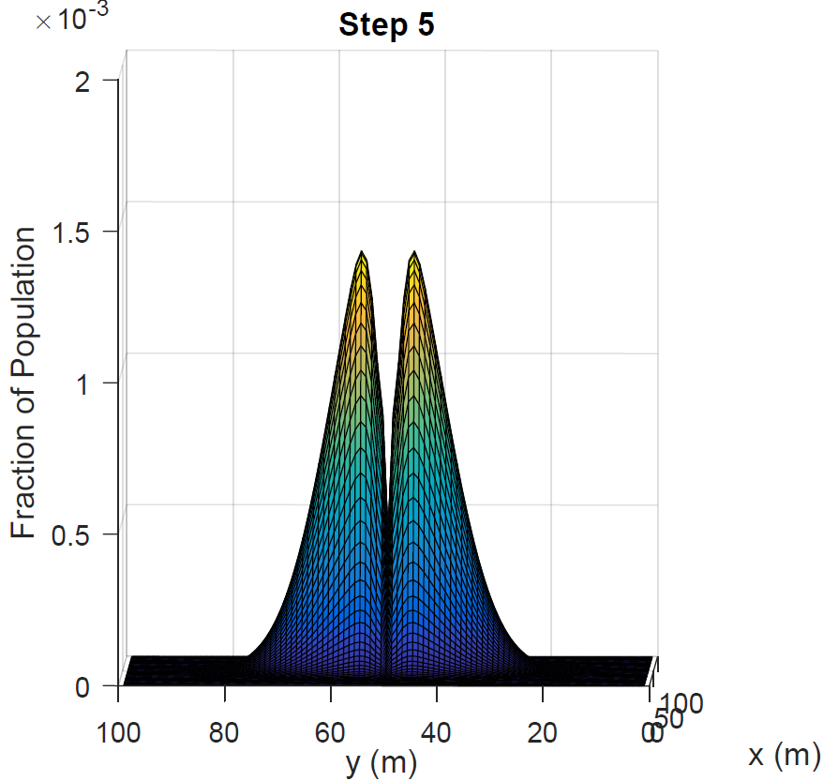



Model Verification
This series of images demonstrates how the distribution reforms after removing a swath of the population through the center (y = 50 m).

Slide 40
Path Planning
Offline Planning
Sets whole plan before starting search
Executes plan as given
Online Planning
Either has no starting plan or modifies plan as robot progresses
Uses feedback

Slide 41




Path Options
Boustrophedon
Square Spiral
Wall-Following
One-Step Greedy
Hybrid
Two-Step Greedy

Slide 42
Testing Variations
Sticky Walls | Normal Distrib.
Wall-Following | Square Spiral Out
Boustrophedon | Square Spiral Out to 50%, In to Center
Hybrid | Square Spiral Out to 80%, In to 80%
Square Spiral In | One-Step Greedy
One-Step Greedy | Two-Step Greedy
Two-Step Greedy
Parameter | Values Tested
Time T | 300 s, 600 s
Robot velocity | 6 m/s, 9 m/s, 12 m/s
Particle movement k | 0.2, 0.4, 0.6
Removal rate | 0.5, 0.7, 0.9
Row spacing | L/50, L/20, L/10, L/5
Sticking coefficient s | 0.25, 0.5, 0.75
Standard deviation σ | L/20, L/10, L/5, L/2
L is the length of the workspace

Slide 43

Sticky Wall Simulation

Slide 44

Normal Distribution Simulation

Slide 45

Sticky Wall Results - Overall
1. Two-step greedy
2. Hybrid
3. Square Spiral
4. Boustrophedon
5. Wall-Following
6. One-Step Greedy

Slide 46


Sticky Wall Results – Area Extremes
Lowest speed, shortest time
Highest speed, longest time

Slide 47




Sticky Wall Results
Sticking Coefficient
Particle Transition Probability
Row Spacing
Removal Rate

Slide 48
Short-Sighted One-Step Greedy
95
96
97
98
99
Robot in blue cell
One-step chooses (1,98) for next move
Two-step chooses (2,97) for next move
1
0.07
0.06
0.31
0.47
0.39
2
0.44
0.42
0.38
0.32
0.25
3
0.58
0.55
0.49
0.41
0.31
4
0.70
0.66
0.59
0.48
0.37

Slide 49
Sticky Wall Results
Relative performance of paths is affected by the fraction of the population around the edges
Parameters that keep more at edges favor methods that remain near the walls longer
Parameters that reduce population at edges favor methods with better exploration of the center

Slide 50


Normal Distribution Extreme Cases
Instantly Reform
Never Reform

Slide 51

Normal Distribution Results – Overall
1. Two-step greedy
2. One-step greedy
3. Square spiral with 50% return to center
4. Square spiral with 80% thresholds
5. Square spiral out

Slide 52

Normal Distribution Results Area Extremes

Slide 53




Normal Distribution Results
Standard Deviation
Particle Transition Probability
Row Spacing
Removal Rate

Slide 54

Stationary Collection
Consider an immobile collecting robot/device
Located at center of workspace
Can have a constant power source
Assuming mobile robot runs four times per day, T = 21,600 s for stationary device
Normal distribution – can collect 99.9%
Sticky walls – can collect 9.7%
Can be very effective when particles are
attracted toward its location
Image by Malcolm Koo
CC-BY-SA 3.0

Slide 55

Discussion
Two-step greedy has best results in both environments but also requires most sensing
More steps would lead to better performance but take more computation time
In right conditions, wall following or immobile collector can be feasible

Slide 56
Conclusions
Investigated a new problem in robotic coverage
Maximize number of moving particles collected from a swarm
Individual simulations with biased particles
Markov process simulations with uniform distribution but with sticky walls
Markov process simulations with normal distribution
Pre-planned paths and feedback-based paths

Slide 57
Conclusions (con’t)
For sticky walls, relative merit of paths varies with environment and swarm parameters
For normal distribution, relative merit of paths is independent of parameters chosen
Many directions open for further research
Multiple robots
Combination environments
Increased greedy steps
Obstacles
Particles that react to the robot
Image by An Nguyen

